Slide 1
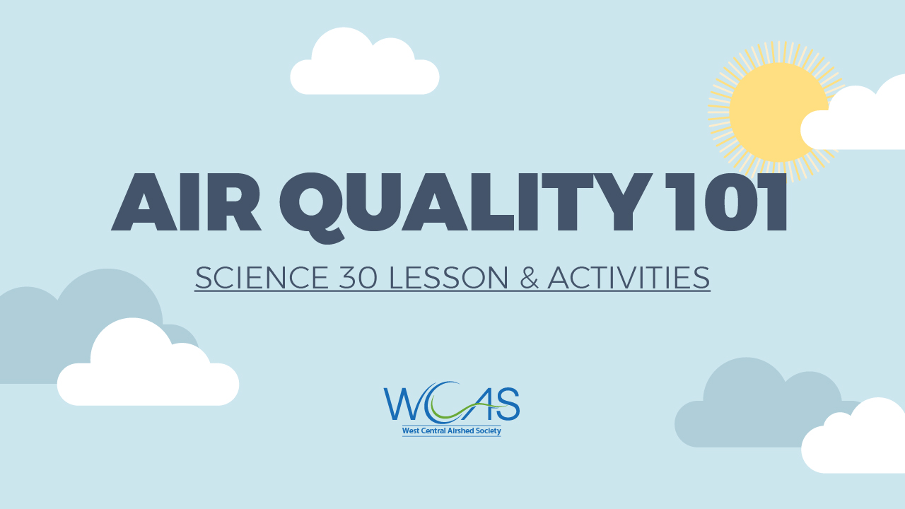
Notes:
No notes.

Slide 2

Notes:
No notes.

Slide 3


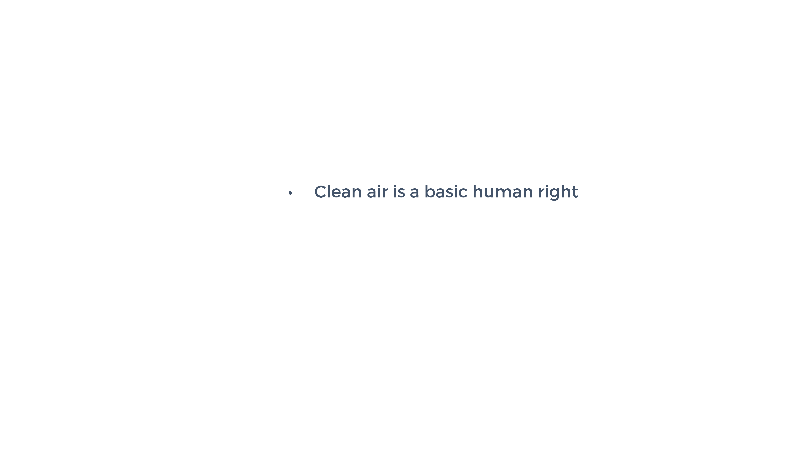
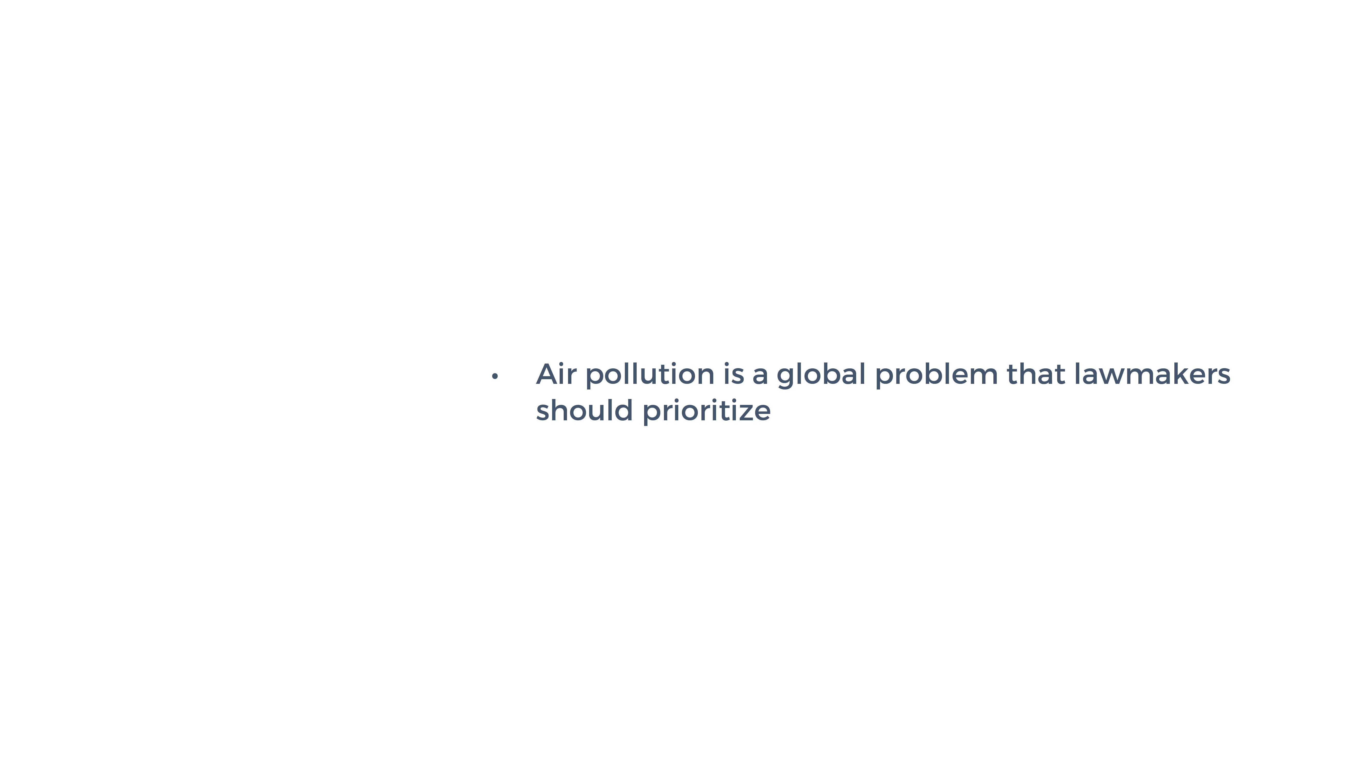
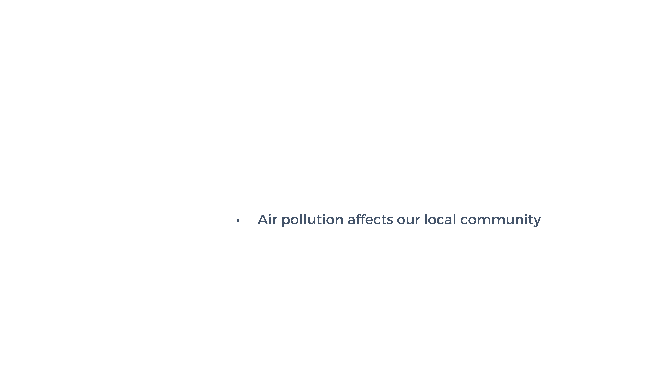
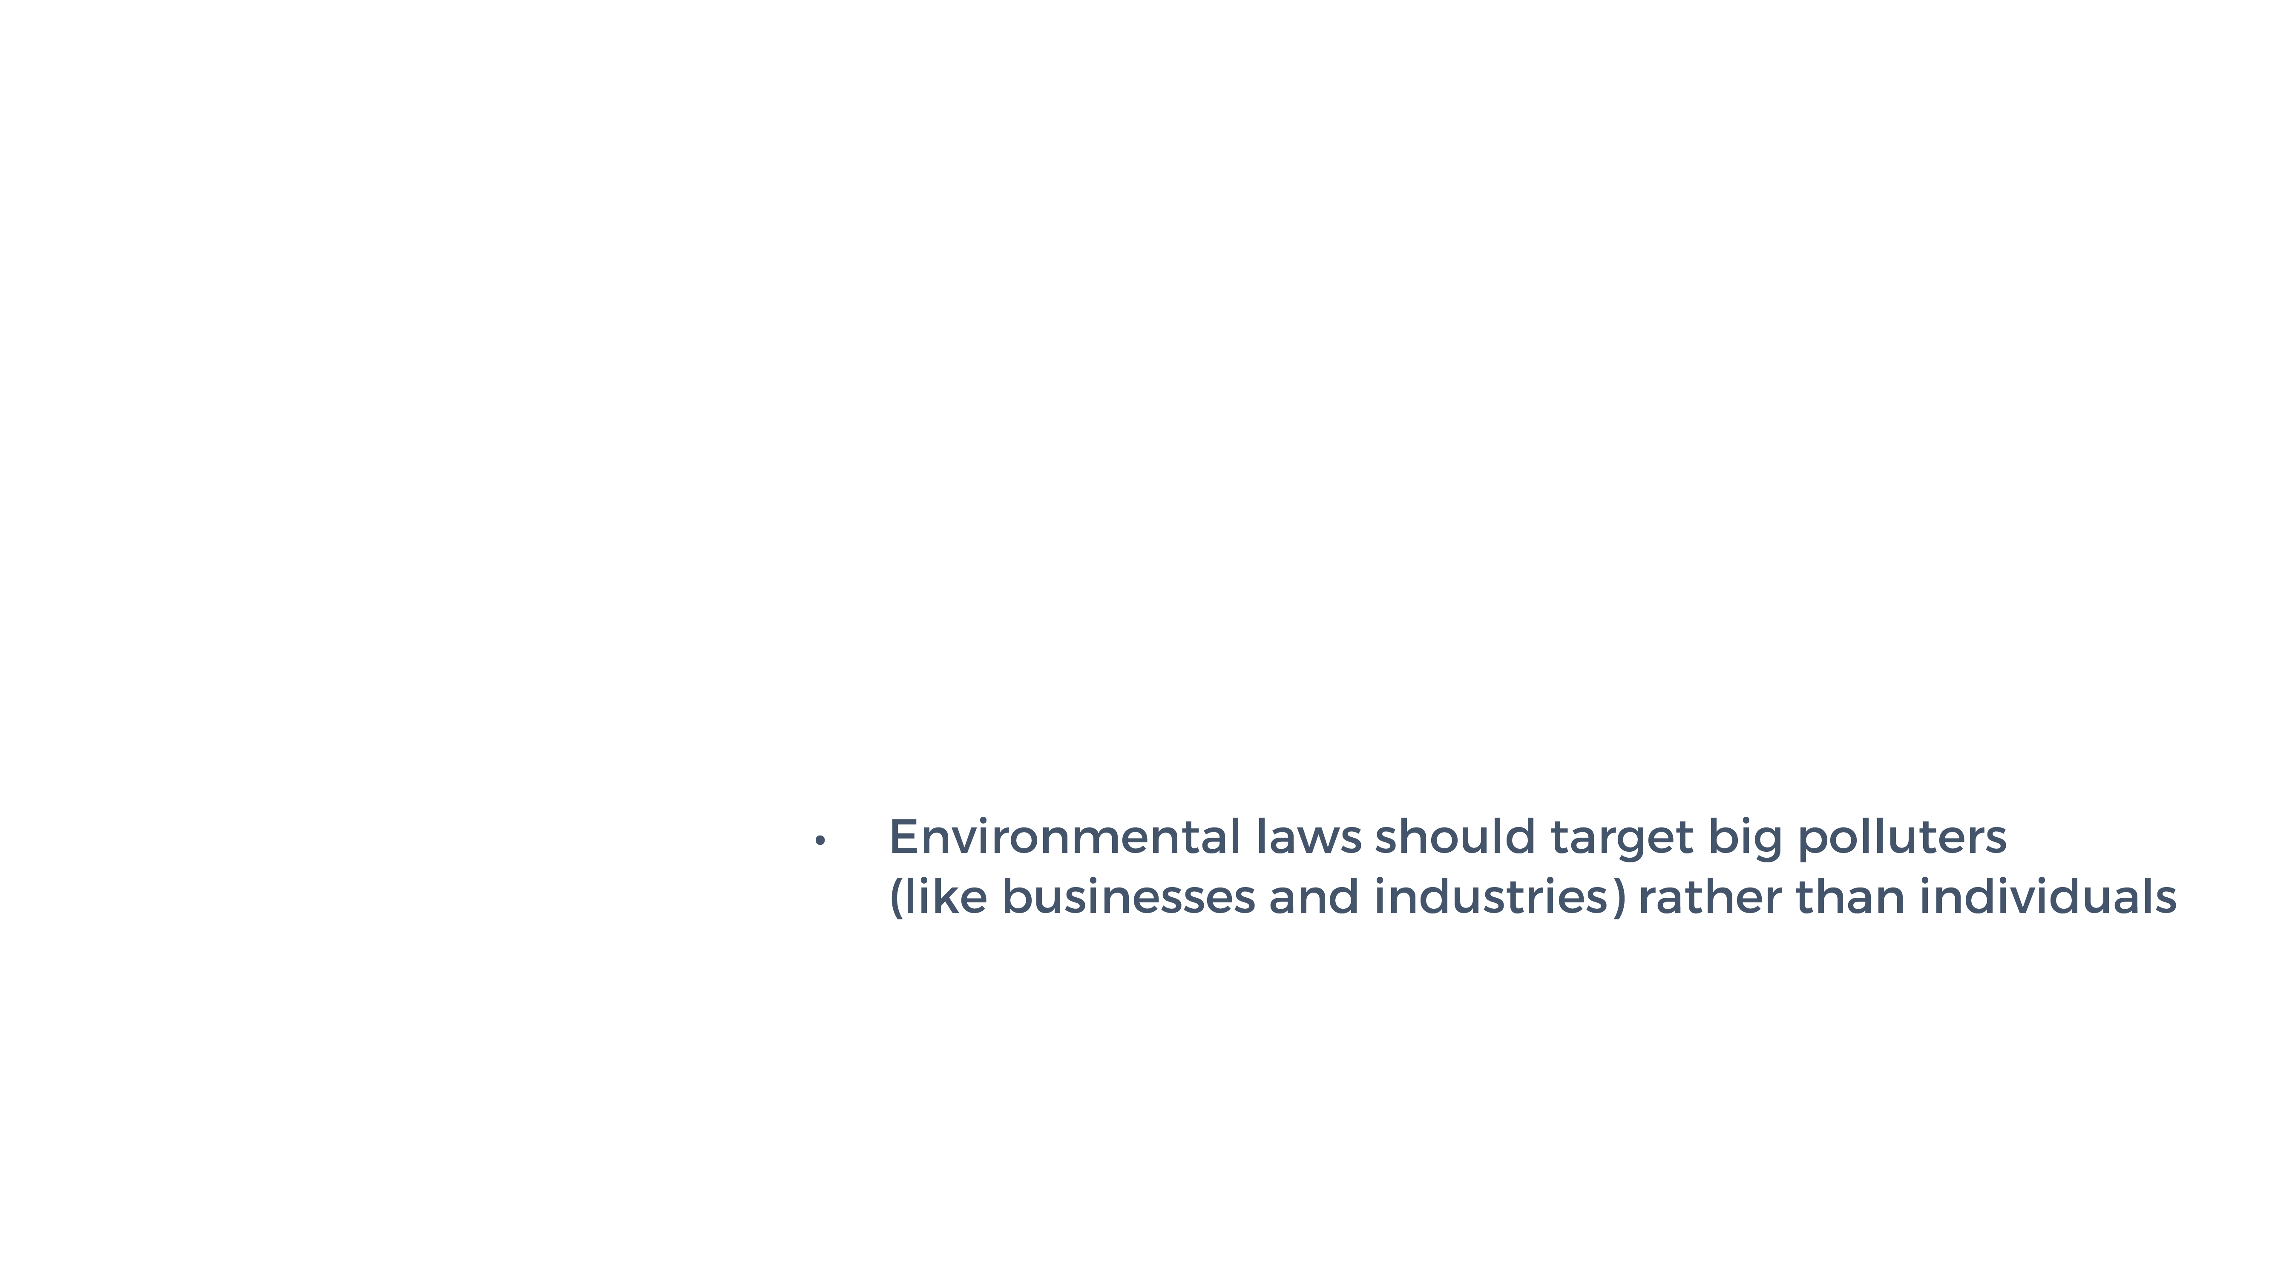

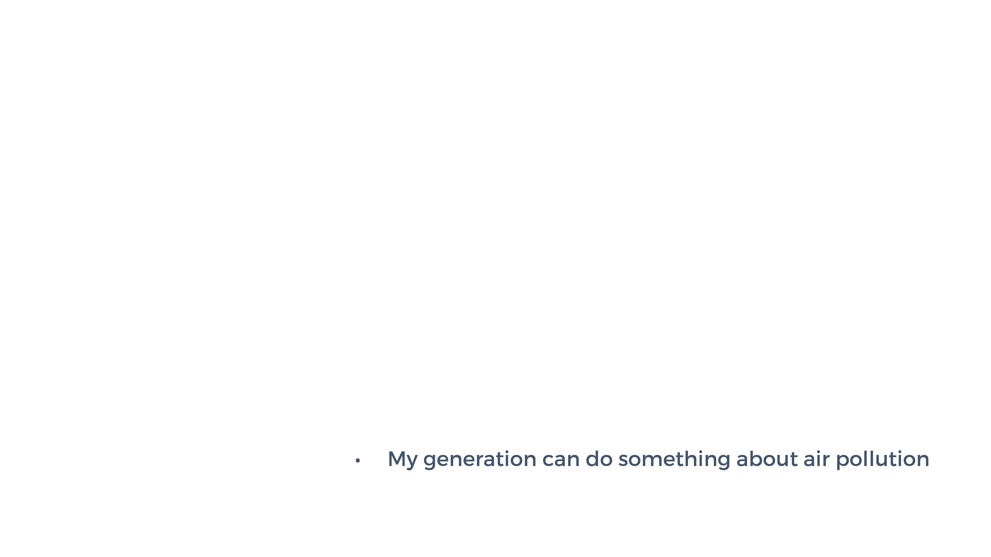
Notes:
See activity instructions in the Teacher Guide.
Where students place themselves along the value line is not as important as the conversation it creates…
In the lesson that follows, we will learn about air quality and the environmental factors that determine how much of an impact air pollution has on living things and the planet.

Slide 4
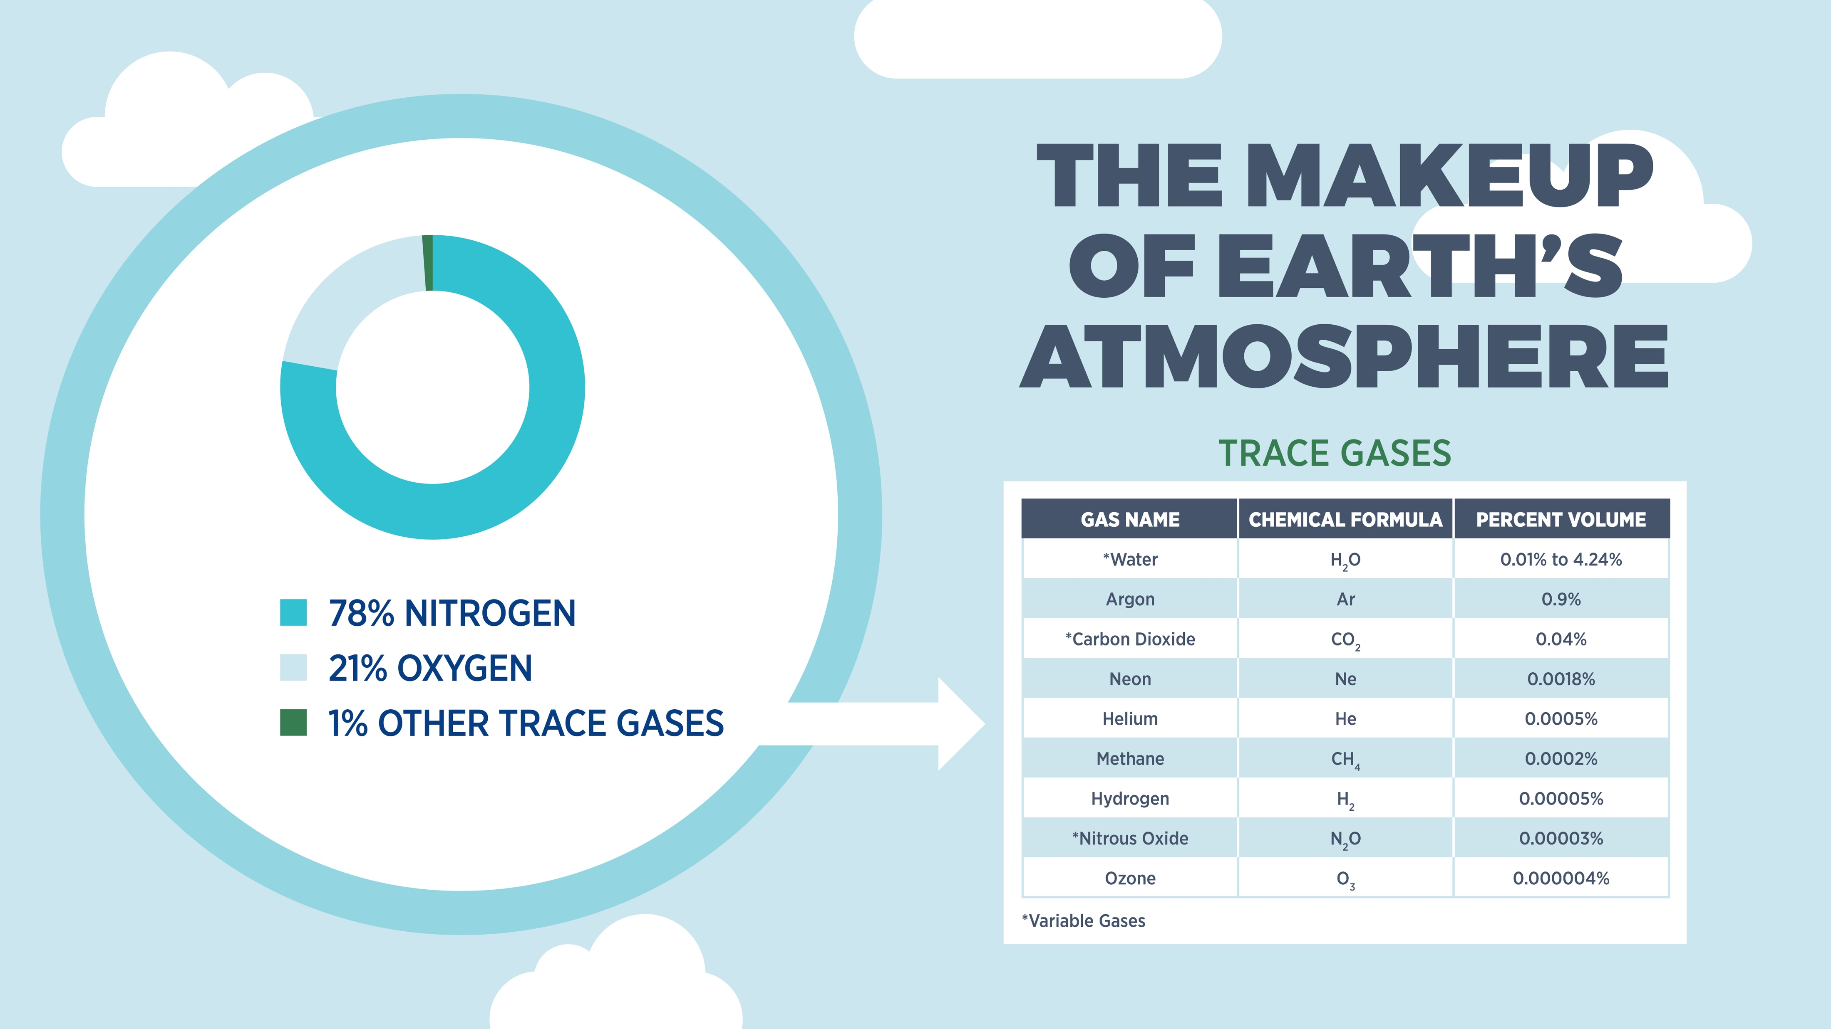
Notes:
We live at the bottom of a large pool of air known as the atmosphere. The atmosphere is essential for life on Earth as it contains important gases and nutrients that living organisms need to survive.
The atmosphere is made up of mostly colourless and odourless gases, like nitrogen (78.1%) and oxygen (20.9%). POINT OUT IMAGE ON THE SLIDE. Other gases are also present in very small amounts, such as argon, carbon dioxide, and methane (for a combined total of 1%) – we call these substances “trace gases.” POINT OUT TABLE LISTING THE VARIOUS TRACE GASES, EMPHASIZING THE ‘PERCENT VOLUME’ COLUMN.

Slide 5
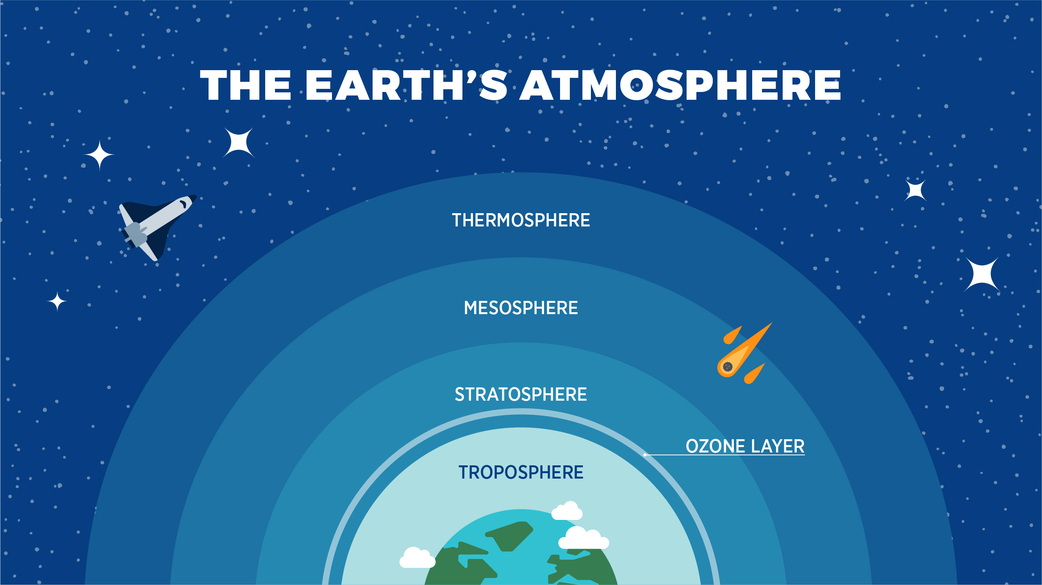
Notes:
There are several different regions or layers in the atmosphere, each with their own characteristics. We live in the bottom layer of the atmosphere, known as the troposphere, where 99.1% of Earth’s water can be found and where most of the planet’s weather occurs.
Now, take a moment to locate the ozone layer. This region of the stratosphere, also known as the “ozone shield,” makes life on Earth possible by protecting us from the Sun’s harmful UV rays. While we need some of the Sun’s radiation to live, too much of it can cause skin cancer and cataracts in humans as well as damage to plants, animals, and other materials. Like a sponge, the ozone layer absorbs almost all of the Sun’s radiation before it has a chance to reach Earth’s surface. Certain air pollutants (like CFCs) can cause this protective layer to thin.
CFCs, or chlorofluorocarbons, are human-made compounds containing chlorine, fluorine, and carbon. These substances were commonly found in refrigerants, aerosol sprays (like hairspray and deodorant), cleaning solvents, and insulation materials. Since scientists linked CFCs to the depletion of the ozone layer back in the 1970s and 80s, they have been phased out in many parts of the world. The case of CFCs illustrates the importance of studying the impacts and consequences of air pollution.

Slide 6
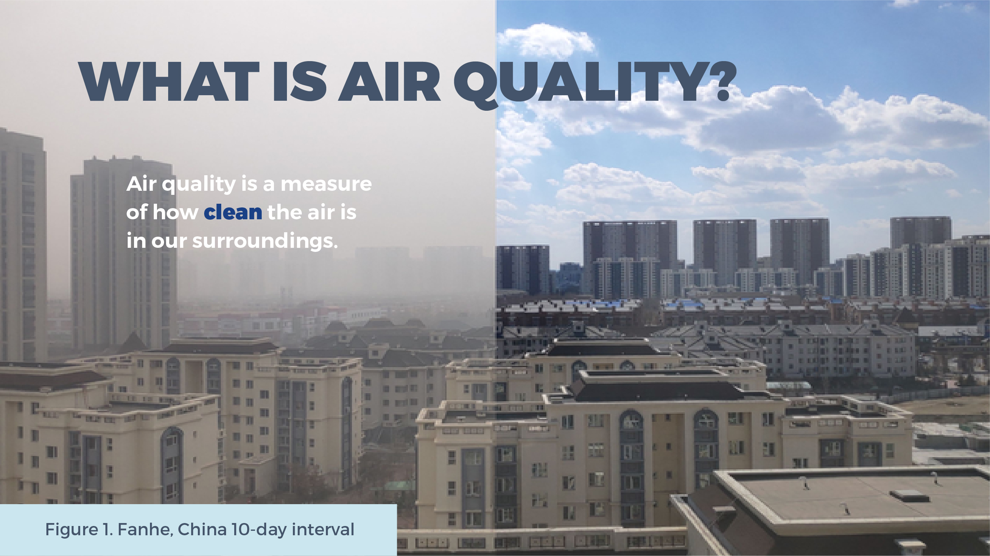
Notes:
Air quality is a measure of how clean the air is in our surroundings. Clean air contains only the gases and water vapour necessary to support a healthy environment. Keeping this in mind, how might we define air pollution? [Answer: airborne substances, either not found in the normal composition of the atmosphere or found at higher-than-normal levels, that can harm living things and other materials or resources].
When released into the atmosphere, pollutants change the characteristics of our air and can make it hard to breathe. Good air quality means that the air is relatively clean, clear, and free of pollutants. Poor air quality means the air contains a high concentration of pollutants. POINT OUT IMAGE OF FANHE, A TOWN IN CHINA, TO HIGHLIGHT THIS DIFFERENCE. These photos were taken only 10 days apart.
Figure 1. Fanhe, China. From Fanhe Town 10 day interval contrast by Tomskyhaha, 2019. https://en.wikipedia.org/wiki/Smog#/media/File:Fanhe_Town_10_day_interval_contrast.png

Slide 7
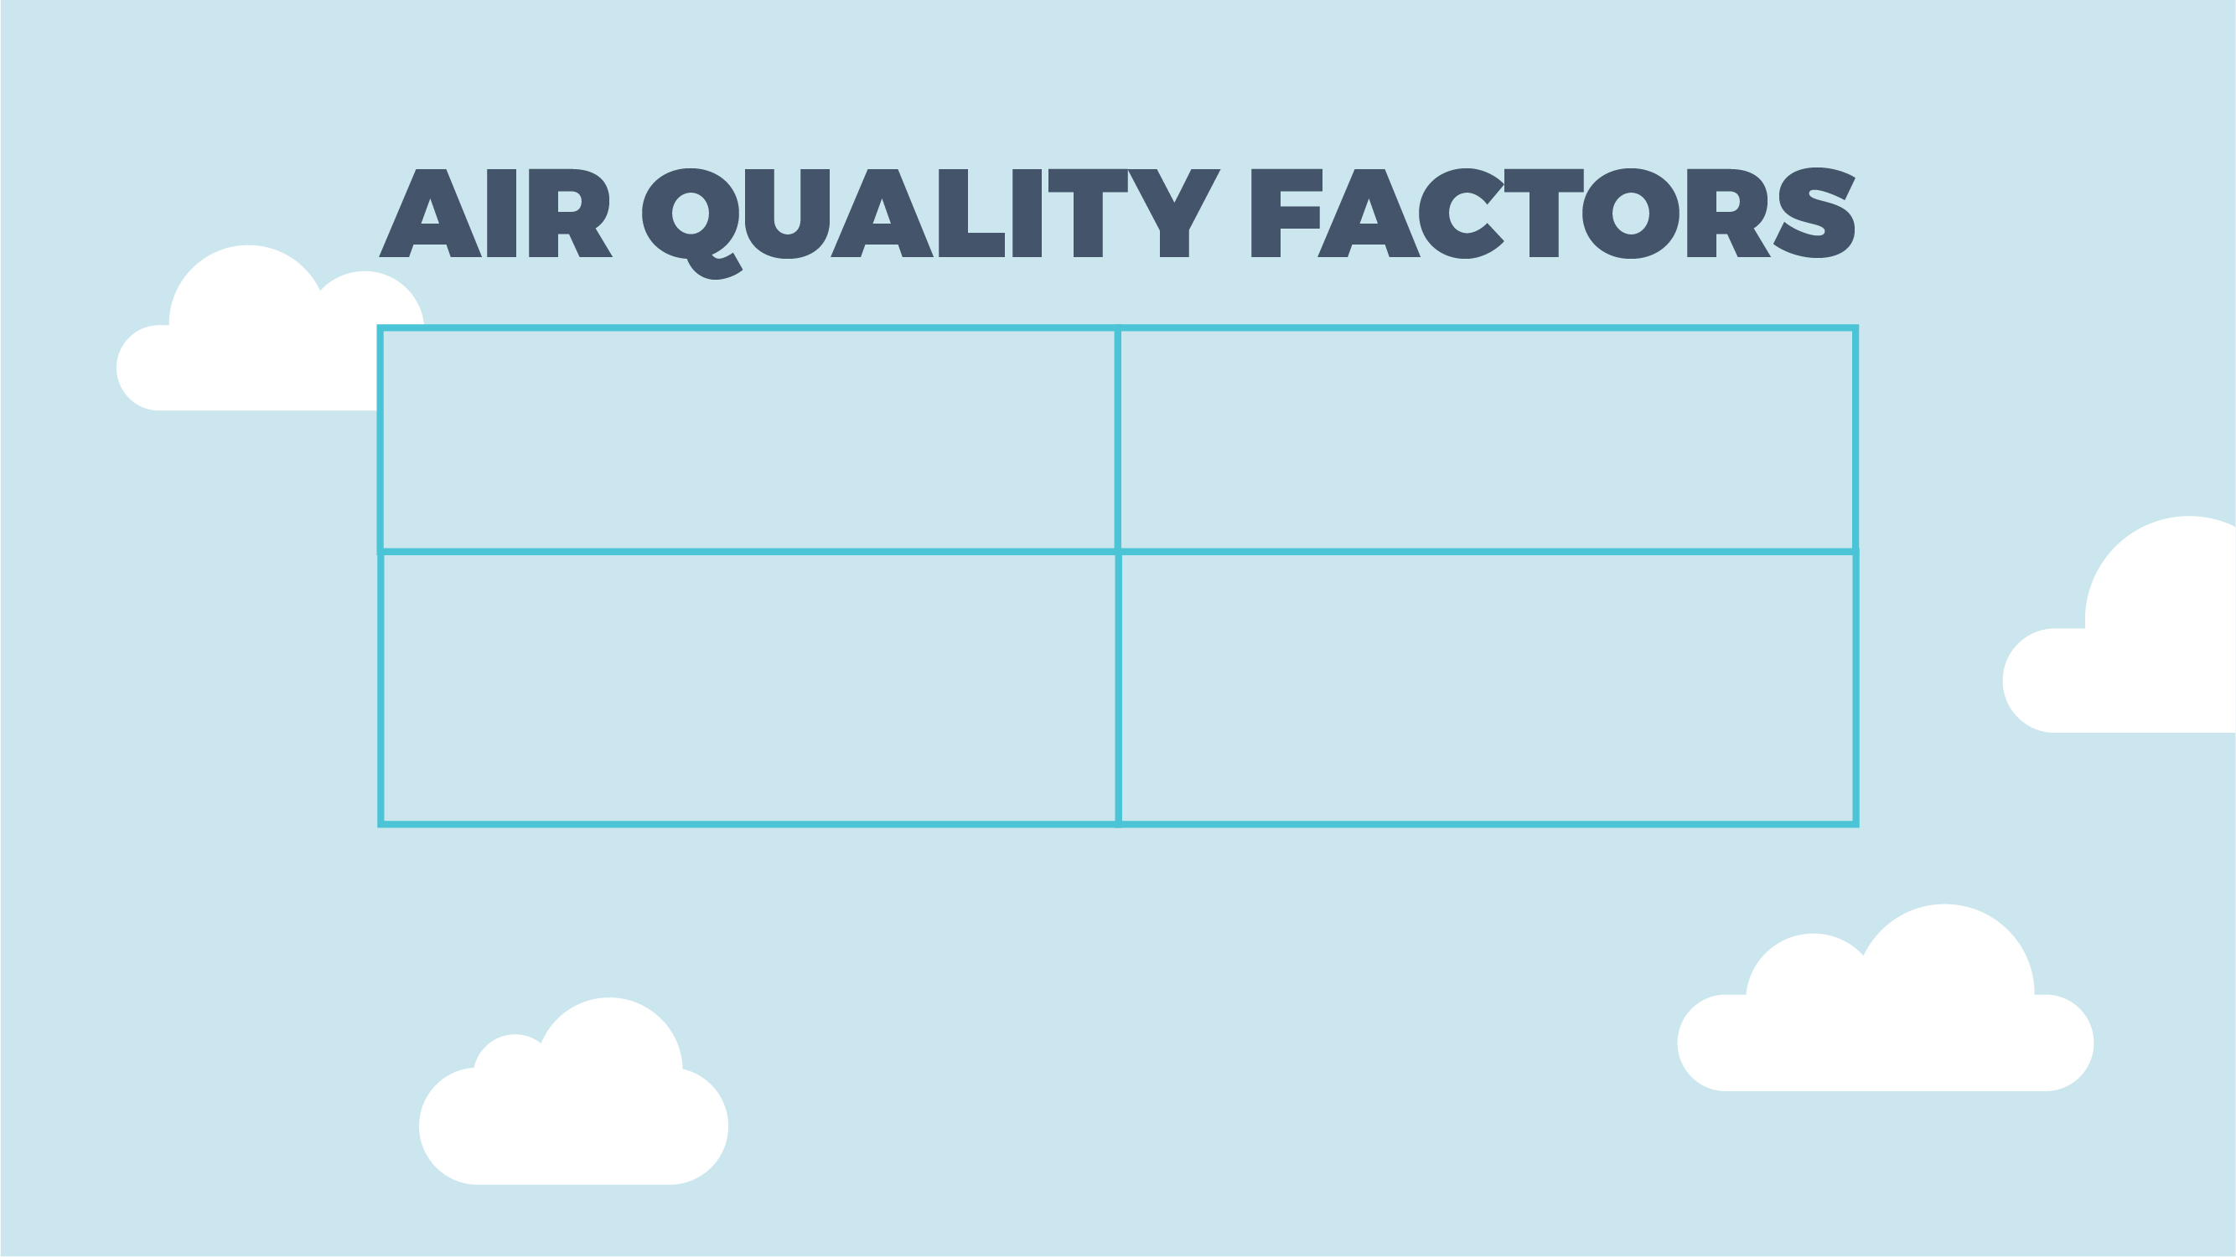





Notes:
The quality of our outdoor air is determined by a number of factors. These include:
CLICK SLIDE TO REVEAL ANIMATION.
1. Sources: refers to where pollutants come from. It includes any activity, event, or process that emits pollutants into the atmosphere.
CLICK SLIDE TO REVEAL ANIMATION.
2. Emissions: refers to the pollutants released into the atmosphere that cause harm to living organisms and the environment. Broadly speaking, there are two categories of air pollutants: gases and particles.
CLICK SLIDE TO REVEAL ANIMATION.
3. Chemical transformations: refers to the chemical reactions and changes that pollutants can undergo once they enter the atmosphere.
CLICK SLIDE TO REVEAL ANIMATION.
4. Dispersion: refers to how pollutants move through the atmosphere. Local air quality depends to a large extent on the ability of the atmosphere to scatter (or disperse) pollutants.
CLICK SLIDE TO REVEAL ANIMATION.
In order to assess local air quality, scientists measure the concentration of various pollutants in our air. The higher the concentration, the more we are at risk.

Slide 8
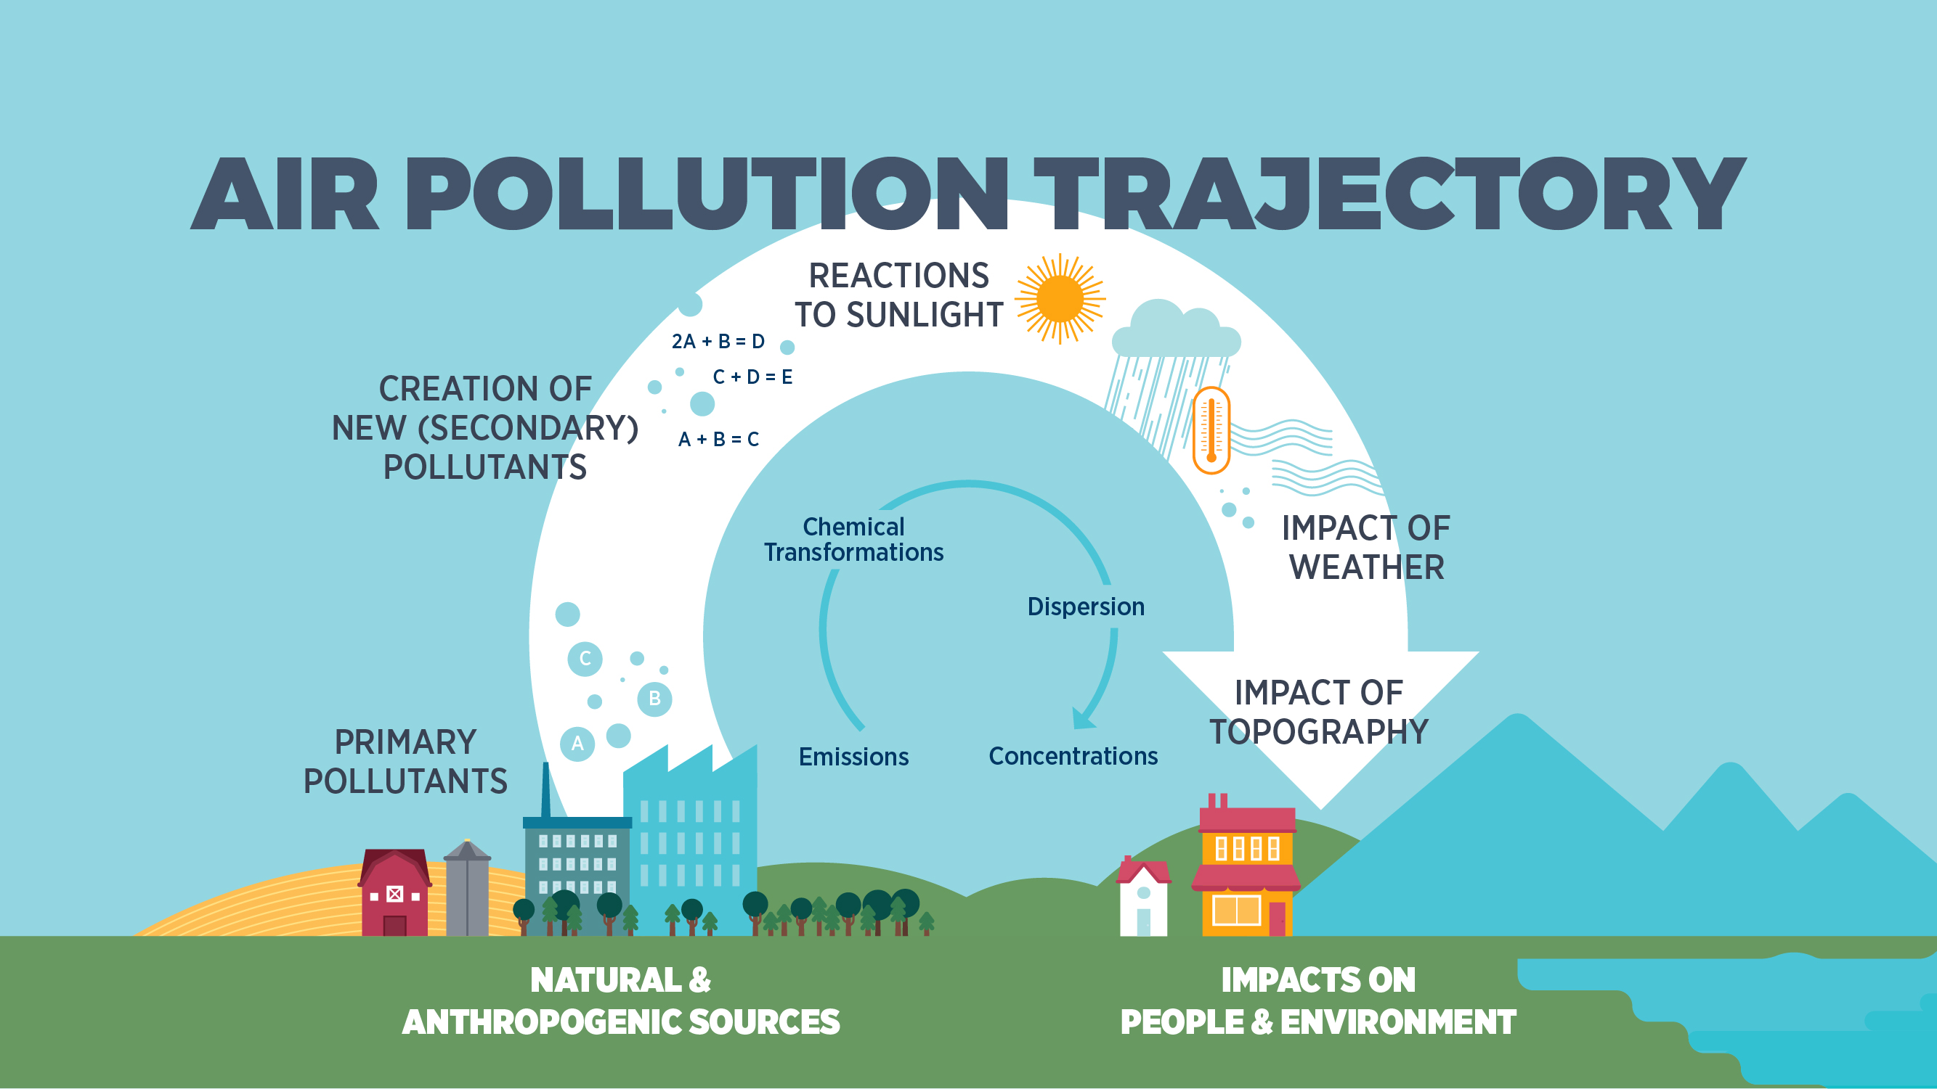
Notes:
Sources
Not all air pollution can be blamed on human activities. Pollutants are emitted from both natural and anthropogenic (or “human-generated”) sources. POINT OUT IMAGE.
Emissions
Air pollutants can be classified as either primary or secondary pollutants. Primary pollutants are harmful gases and particles emitted directly by a source. POINT OUT IMAGE (A, B & C ARE PRIMARY POLLUTANTS).
Chemical Transformations
Once emitted into the atmosphere, pollutants can undergo a variety of changes. Chemical reactions can occur, which break down the original pollutant or convert it into new compounds. POINT OUT IMAGE.
Secondary pollutants are those that form in the air as a result of interactions between different primary pollutants or between primary pollutants and other components of the atmosphere, such as oxygen, water, and sunlight.
Dispersion
The ability of the environment to disperse pollution plays a big role in determining local air quality. Rates and patterns of dispersion depend largely on:
weather conditions (e.g., like temperature, wind, and precipitation) local and regional topography (e.g., valleys, mountains, and lakes)
POINT OUT IMAGE. The constant moving and mixing of air allows the atmosphere to dilute and absorb certain amount of air pollution. Poor air quality often occurs when the air is stagnant (or unmoving), allowing pollutants to build up and concentrate in an area.
Concentrations
The concentration of pollutants in the air ultimately determines how much of an impact these substances have on people and the environment. When pollutant concentrations are high, we see negative impacts on the health of humans and ecosystems. POINT OUT IMAGE.

Slide 9
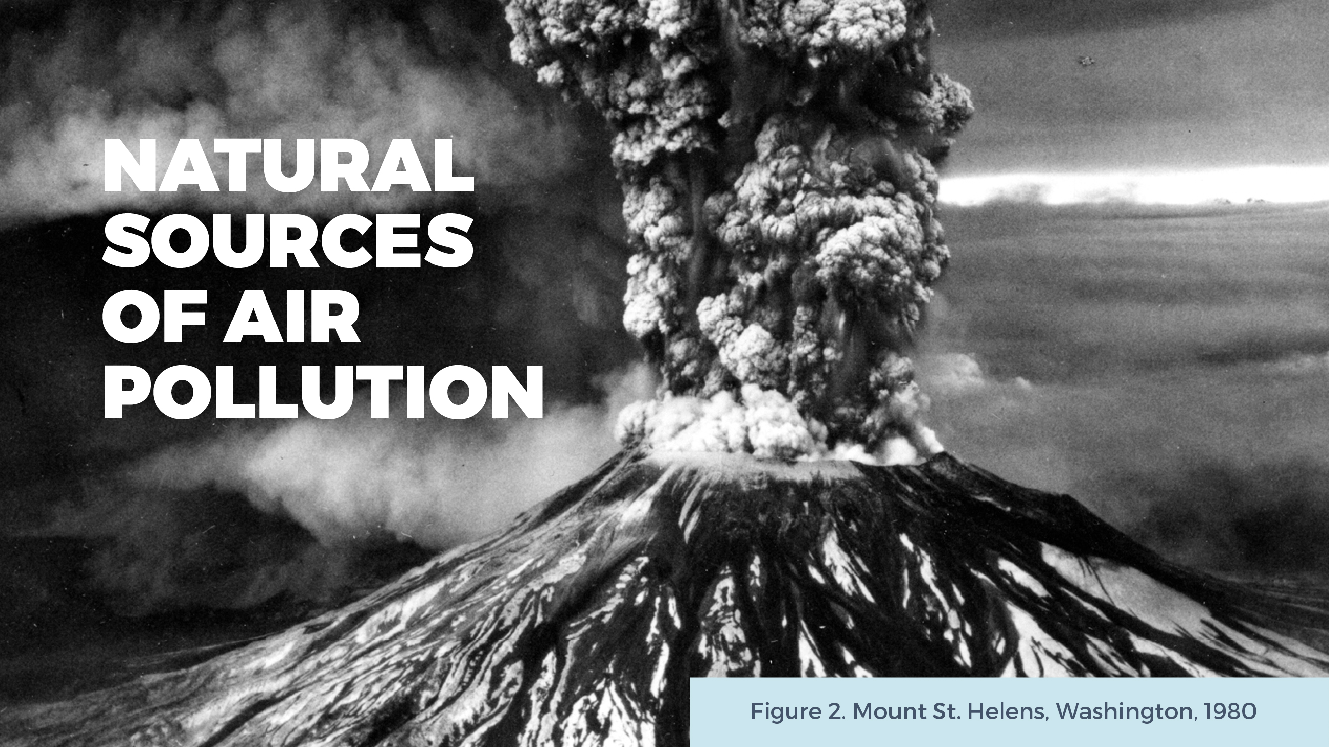

Notes:
Natural sources can contribute significantly to poor air quality, but they do not usually produce ongoing pollution problems. Can you think of some natural sources of air pollution? CLICK SLIDE TO REVEAL ANSWERS. [Answers: volcanic eruptions, dust and sandstorms, lightning, and wildfires].
POINT OUT IMAGE OF THE MOUNT ST. HELENS ERUPTION IN 1980. Although this eruption originated in Washington state, wind carried debris from the explosion into Alberta. Enough ash accumulated in southern Alberta to reduce visibility and cause problems for people with respiratory illnesses; a light dusting of ash was even reported as far north as Edmonton. This example illustrates that air pollutants can travel long distances and sources of pollution do not need to be close by in order to have an effect locally.
Figure 2. Mount St. Helens Eruption from Mount St. Helens Eruption – 1980 by US Geological Survey, 2003. https:// www.flickr.com/photos/usgeologicalsurvey/1170759284

Slide 10
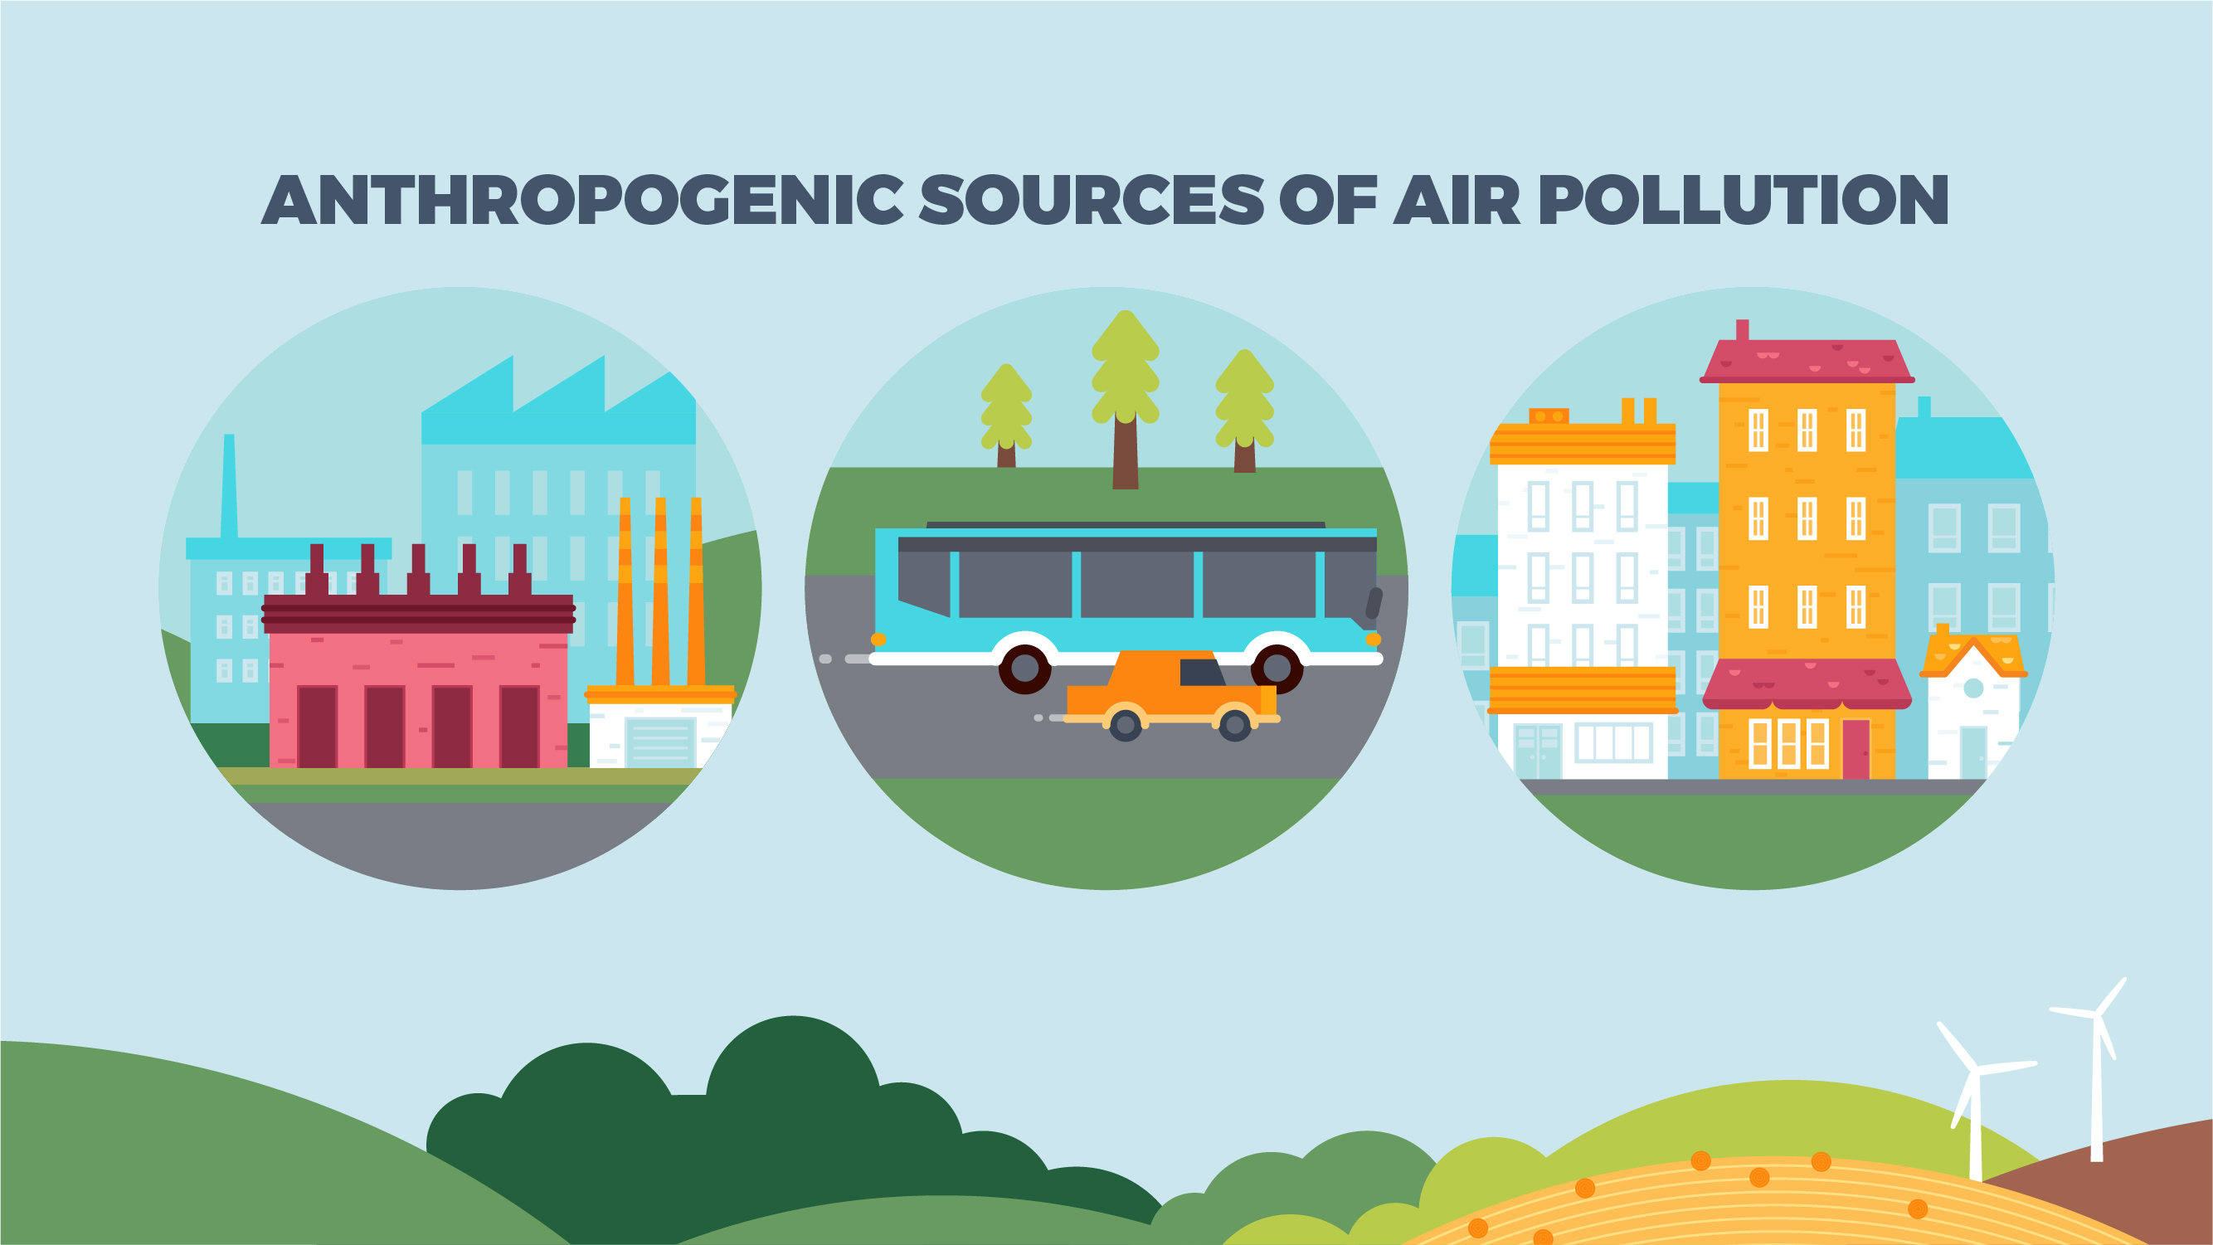
Notes:
Human activities account for a far greater percentage of certain emissions than natural sources. Anthropogenic sources of air pollution can be found in our current patterns of energy production and consumption, as well as in our manufacturing industries and in the products that we produce and use.
Can you think of some anthropogenic (or human-generated) sources of air pollution? WRITE DOWN AND DISPLAY THE ANSWERS THAT STUDENTS PROVIDE. [Answers: transportation (i.e., cars, trucks, buses, trains, airplanes, etc.), power plants, home heating and cooling, wood burning, industrial activities, oil and gas extraction and production, agriculture/farming, landfills, waste treatment plants, pulp mills, etc.].
CLICK SLIDE TO REVEAL ANIMATION. Anthropogenic sources of air pollution can be divided into three categories: (1) Point Sources, (2) Mobile Sources, and (3) Area Sources.
Point (or Stationary) Sources: include any pollutant that enters the environment from a single, easily identifiable, and confined space. Of the source we’ve named, which ones could be considered point sources? [Answers will vary but could include power plants, factories, oil refineries, waste treatment plants, pulp mills, etc.].
Mobile (or non-point) Sources: include any pollutant emitted from a source that produces emissions while moving from one place to another. Of the sources we’ve named, which ones could be considered mobile sources? [Answers will vary but could include cars, trucks, planes, trains, boats, etc.].
Area Sources: encompasses the pollutants released from many small sources located together in one area, rather than a specific identifiable source. Taken individually the pollutants emitted from these small sources may be insignificant, but when combined, they can contribute to a great deal of air pollution. [Answers will vary but could include cities, landfills, and farms/agricultural land].

Slide 11
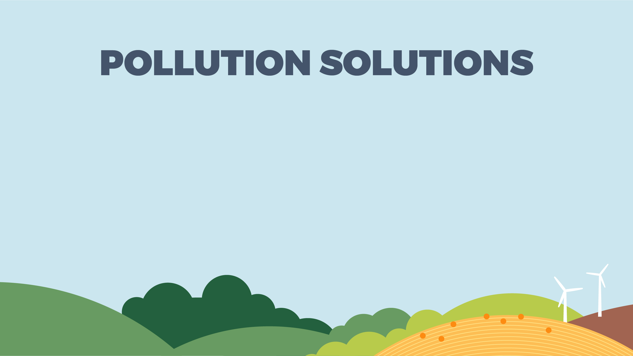
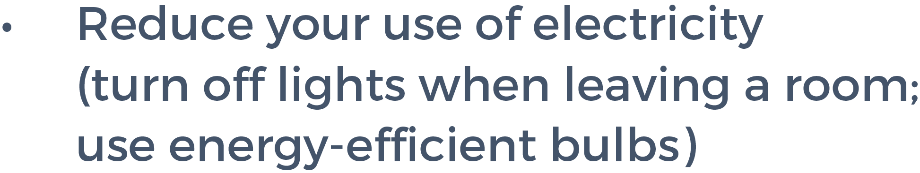




Notes:
Now that you know the sources of human-caused air pollution, what can you and your family do to reduce emissions and help improve local air quality? CLICK SLIDE TO REVEAL ANSWERS.

Slide 12
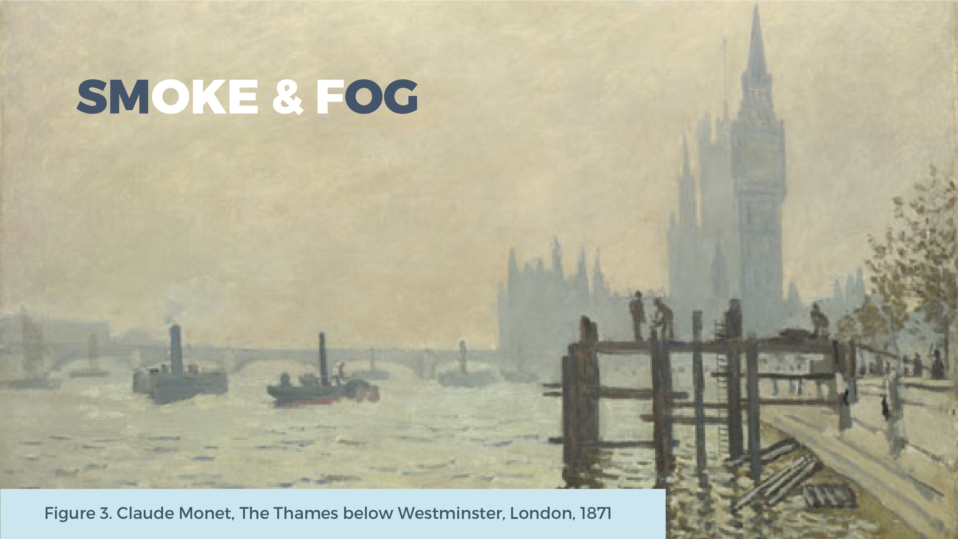



Notes:
Anthropogenic air pollution is often thought of as a recent issue; however, laws seeking to limit this type of air pollution date back to 1306, when King Edward I banned the burning of sea-coal in London—a move that did little to stop this practice.
CLICK SLIDE TO REVEAL ANIMATION. With the Industrial Revolution, the shift from human labour to machinery led to a much heavier reliance on fossil fuels (i.e., coal, oil, and gas). These non-renewable energy resources were— and still are—used to run factories, drive vehicles, generate electricity, and heat homes. When we burn fossil fuels, we release pollutants into the air that are harmful to both human health and the environment.
CLICK SLIDE TO REVEAL ANIMATION. Due to industrial pollution, London’s naturally moist and foggy air had grown smoky and sooty, leading to health problems for many residents. CLICK SLIDE TO REVEAL ANIMATION. In 1905, a London doctor coined the term “smog” to describe the city’s dirty air. The word “smog” comes from combining “smoke” and “fog.”
Today, the term smog is more commonly used to describe the brown haze created when pollutants from motor vehicles (and other sources) react with sunlight. This type of air pollution is more accurately called “photochemical smog.”
Figure 3. Claude Monet, The Thames below Westminster, London, 1871. From The Thames below Westminster by Claude Monet, 1871. https://commons.wikimedia.org/wiki/File:Monet_The_Thames_at_Westminster_1871_Westminster.jpg

Slide 13
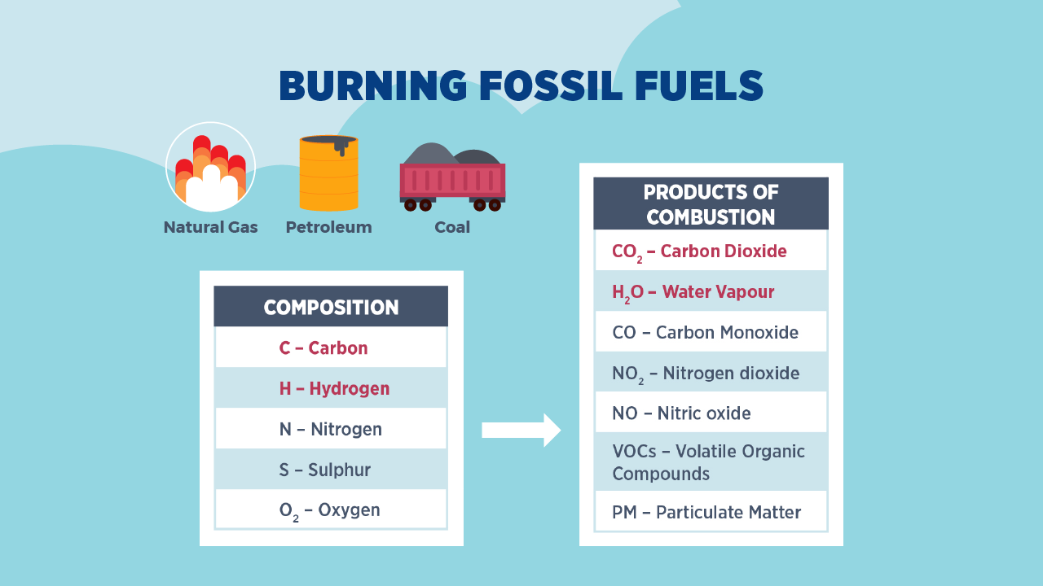
Notes:
Fossil fuels are made up primarily of hydrocarbons (organic molecules containing carbon and hydrogen) but these energy resources also contain varying amounts of impurities such as sulfur, and nitrogen. POINT OUT “COMPOSITION” TABLE. The composition and amount of these elements change depending on the fuel in question.
We burn fossil fuels through a chemical reaction known as combustion. During combustion, a substance (or fuel) reacts rapidly with oxygen to produce energy in the form of heat. Regardless of the type of hydrocarbon, the main products of combustion are carbon dioxide and water vapour. In addition, burning fossil fuels can also lead to emissions of other pollutants due to the presence of impurities in the fuel and the fact that combustion is rarely complete. POINT OUT THE PRODUCTS OF COMBUSTION LISTED IN THE TABLE. These products, as we will see, contribute to a suite of air pollution issues that know no boundaries.

Slide 14

Notes:
Human activity, and especially the consumption of fossil fuels, has led to air pollution issues at a local, regional, and global scale. The following issues will be touched on in this lesson:
CLICK SLIDE TO REVEAL ANIMATION. Local issue: photochemical smog
CLICK SLIDE TO REVEAL ANIMATION. Regional issue: acid rain (or acid deposition)
CLICK SLIDE TO REVEAL ANIMATION. Global issue: greenhouse gases and climate change

Slide 15
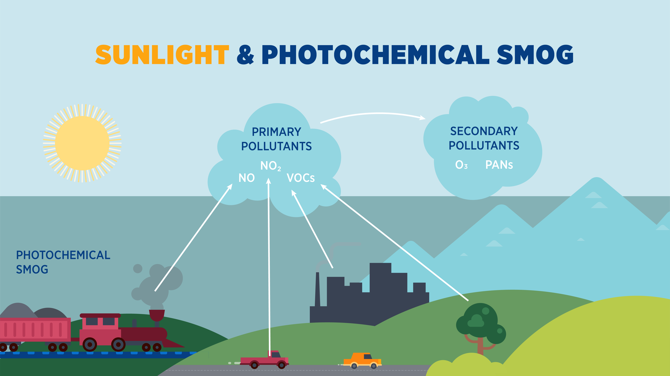
Notes:
Photochemical smog is a specific type of air pollution that is most common in warm, densely populated cities, like Los Angeles and Mexico City.
Photochemical smog is not emitted directly by a source but is instead formed through complex chemical reactions. This process provides a good example of how primary pollutants can transform in the atmosphere to produce dangerous secondary pollutants.
On a clear, cloudless day, intense sunlight can cause chemical reactions to occur among nitrogen oxides (NO, NO2 ) and volatile organic compounds (VOCs)—the primary pollutants seen in the image. POINT OUT IMAGE ON SLIDE. These substances are commonly introduced into the atmosphere by mobile sources (e.g., cars, trains, and planes), industrial processes, and even certain plants and trees. When these chemicals react with the sun’s UV rays, they can form secondary pollutants, such as ground-level ozone and PANs (or peroxyacyl nitrates). POINT OUT IMAGE ON SLIDE. Of the secondary pollutants involved in photochemical smog, air quality scientists are most concerned with ground-level ozone.
Thankfully, hot sunny days are often followed by late-afternoon storms, which can improve air quality. Clouds block sunlight, causing smog production to slow down for the day, while rain washes away impurities in the sky, including the ground-level ozone that has already formed.

Slide 16
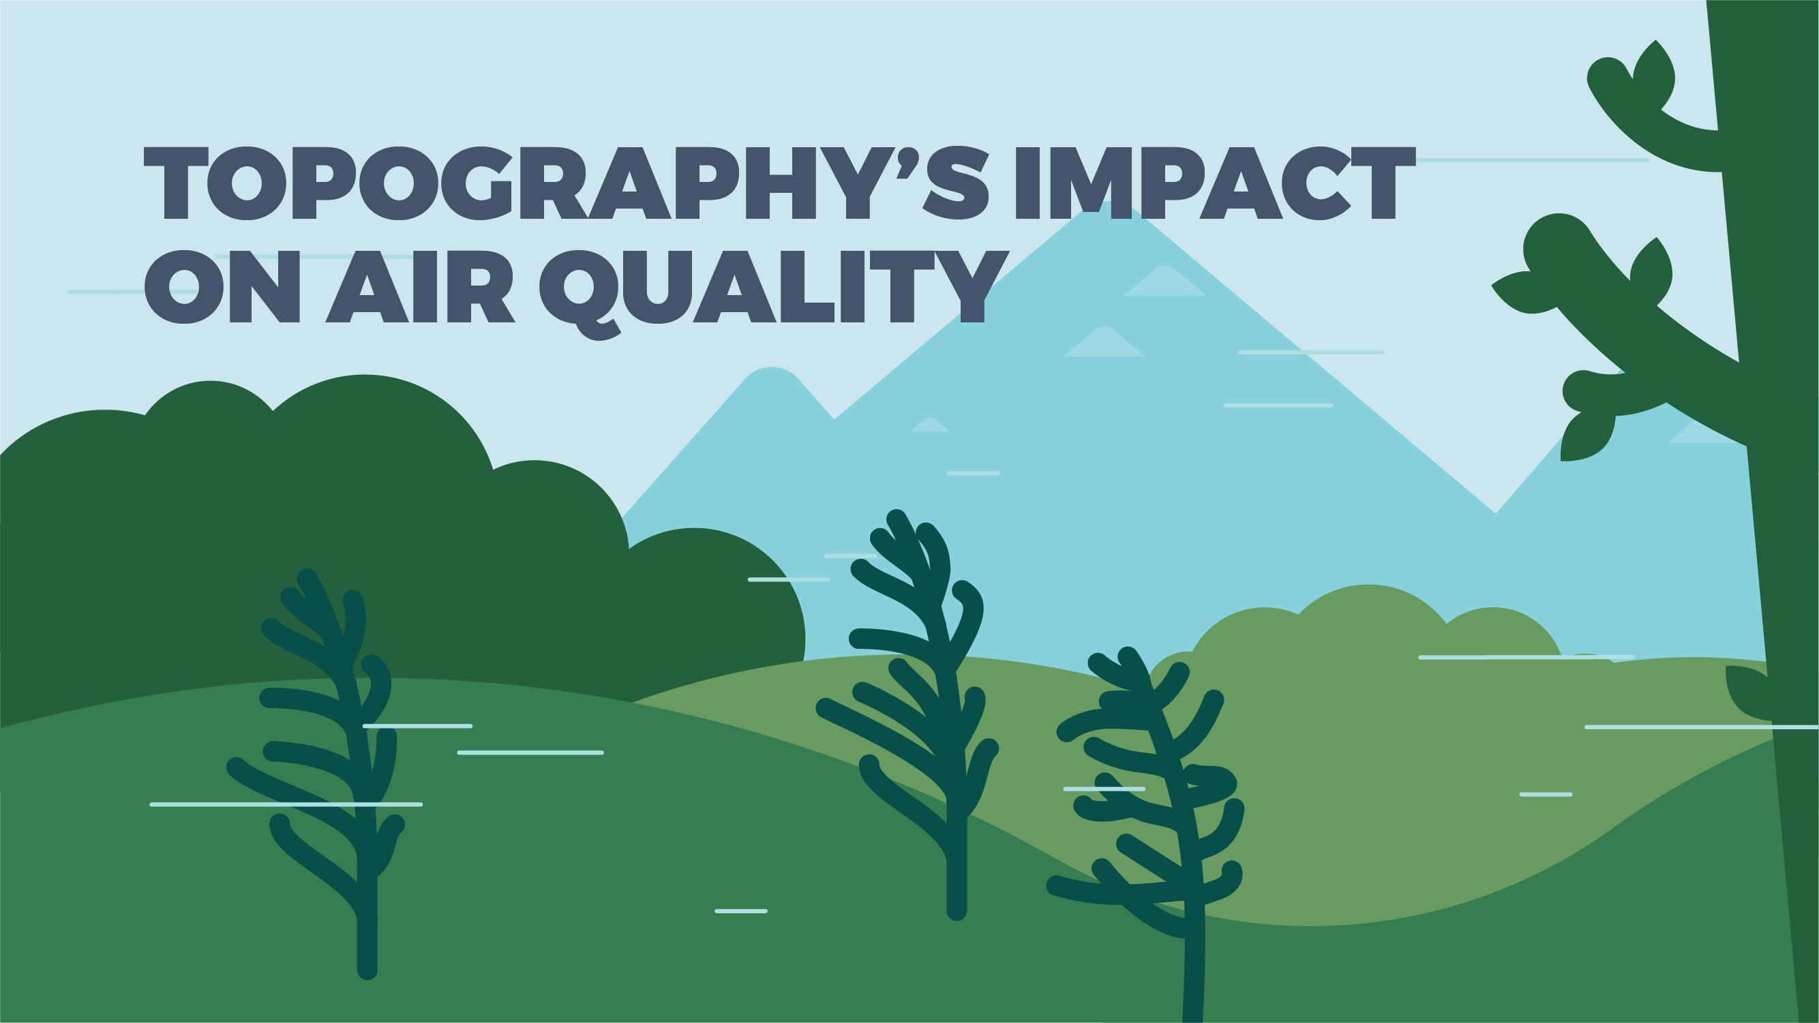
Notes:
Los Angeles and Mexico City are not only prone to photochemical smog because their hot sunny weather and large populations, but also because of the topography around them: both cities are found in basins with mountain ranges nearby.
Because topography can influence and even control how air moves through an area, it plays a role in determining local air quality. Topography can cause pollutants to concentrate in or disperse from an area.
Mountains can act as barriers for wind and prevent air from spreading out, thereby trapping pollutants in low-lying areas, such as valleys and basins. On the other hand, communities located in plains do not have the same restrictions on airflow and may not experience the same build up of smog that cities in basins or valleys are known for.

Slide 17


Notes:
As mentioned, photochemical smog is produced through a series of chemical reactions. The following is a simplified explanation of this process....
CLICK SLIDE TO REVEAL THE FIRST CHEMICAL REACTION: the sun’s ultraviolet light splits nitrogen dioxide into monatomic oxygen and nitric oxide.
CLICK SLIDE TO REVEAL THE SECOND CHEMICAL REACTION: the monatomic oxygen can then react with the molecular oxygen in our atmosphere to produce the secondary pollutant known as ground-level ozone (O3), a dangerous component of photochemical smog.
CLICK SLIDE TO REVEAL THE THIRD CHEMICAL REACTION: normally, ozone would be consumed by nitric oxide, reverting back into nitrogen dioxide and molecular oxygen and resulting in no net gain of ground-level ozone. However, the presence of volatile organic compounds (VOCs) in our air can impede this process….
CLICK SLIDE TO REVEAL THE FOURTH & FIFTH CHEMICAL REACTIONS: when VOCs are present, nitric oxide and nitrogen dioxide are consumed as seen in reactions 4 and 5. These results allow for the build up of ozone in our troposphere.

Slide 18
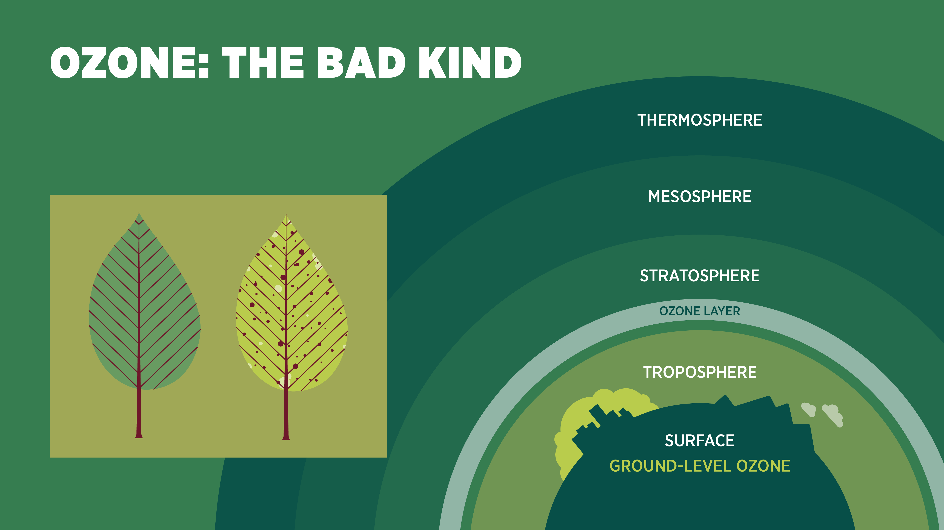
Notes:
The term “ozone” can be confusing. We know that the “ozone layer” in the stratosphere is necessary for life on Earth and in need of protection. However, while naturally occurring ozone plays an important role in protecting us from the Sun’s UV rays, ozone produced near the Earth’s surface (what we call “ground-level ozone”) causes environmental, health, and economic problems. You can remember this with the following rhyme: ozone is good up high but bad nearby.
In fact, ground-level ozone causes more damage to plants, including farming crops, than all other air pollutants combined. Ozone interferes with the process of photosynthesis and inhibits a plant’s ability to open the microscopic pores on their leaves that they use to breathe. When exposed to ground-level ozone, plants can display visible injuries (POINT OUT THE IMAGE ON THE LEFT-HAND SIDE OF THE SLIDE) and can become more susceptible to disease and pests.
Ground-level ozone also negatively affects humans. This pollutant can make it hard for us to breathe deeply, increase the frequency of asthma attacks, and aggravate other lung diseases. Further symptoms include chest pain, coughing, and a scratchy throat.
Lastly, ground-level ozone is considered a greenhouse gas (GHG) that is causing our planet to warm at a quicker rate than is normal.

Slide 19
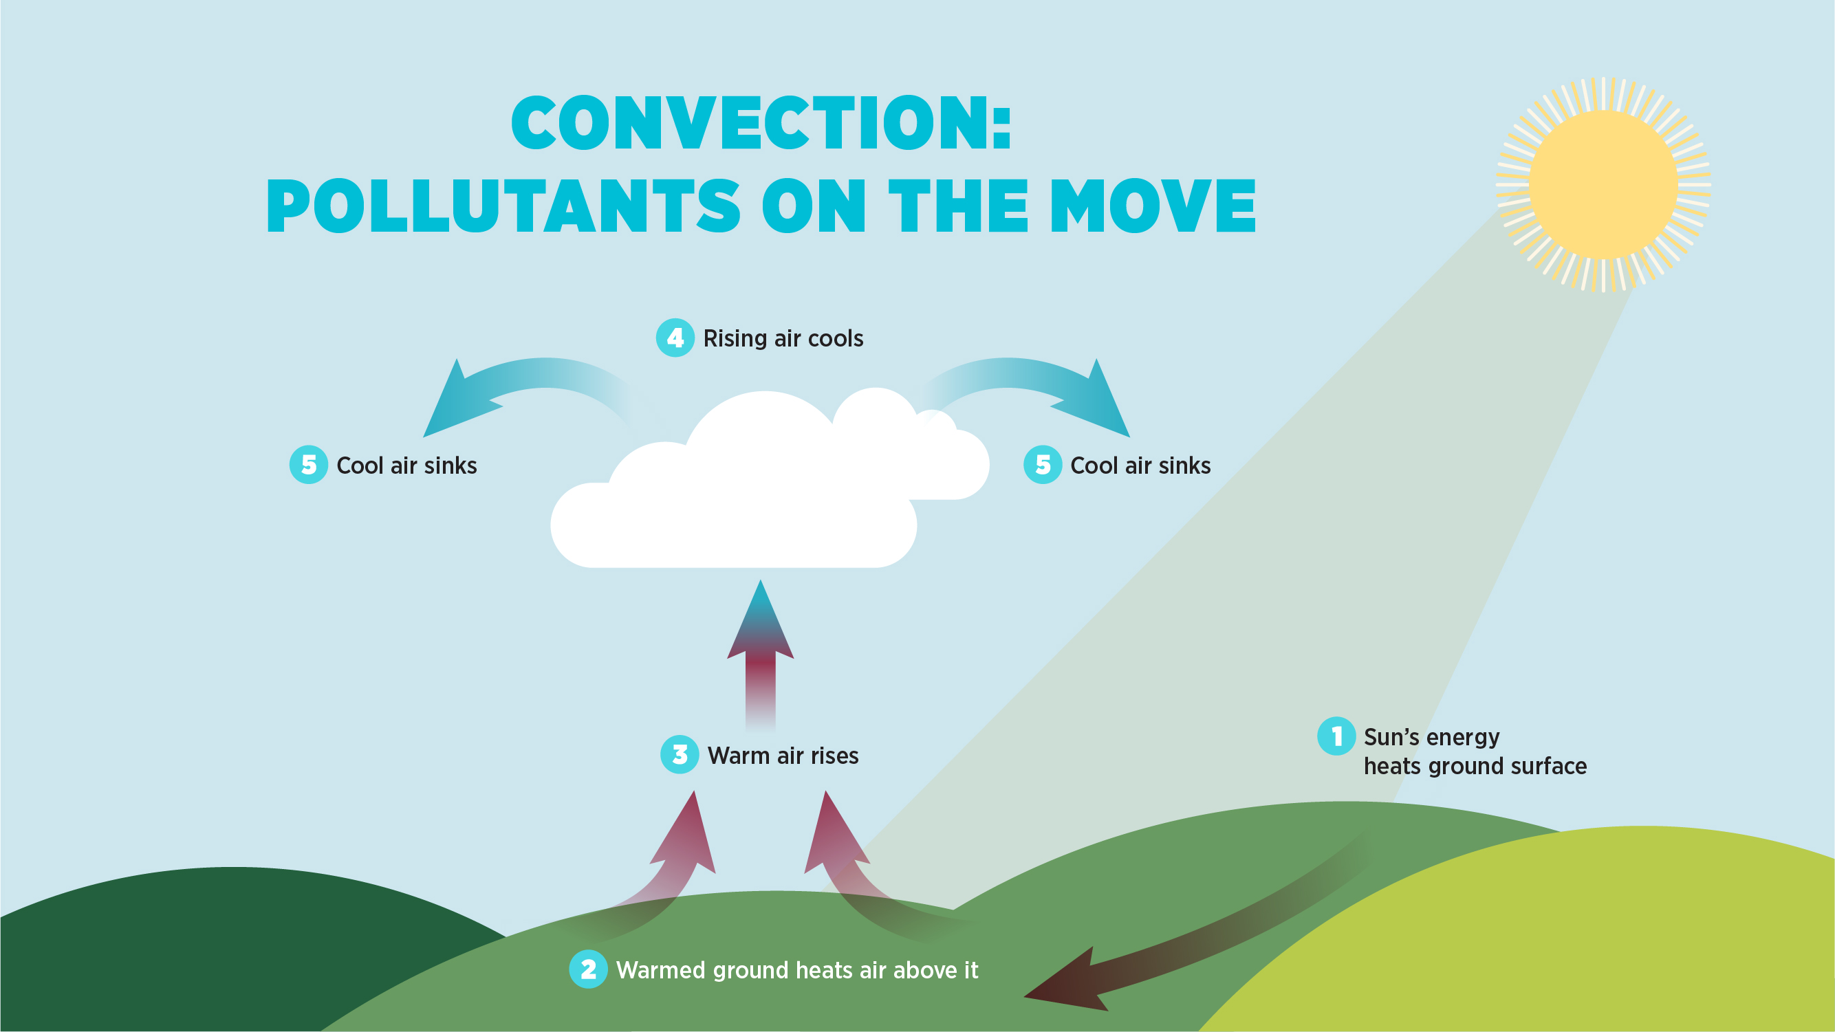
Notes:
Because outdoor air is constantly moving and mixing, air quality can change from day to day, or even from one hour to the next. Temperature is what drives air circulation and helps move air pollution around.
POINT OUT IMAGE ON THE SLIDE. Because energy from the Sun is absorbed by the Earth’s surface, air near the ground is typically warmer than air that is further up in the troposphere. Warm air is less dense, so it rises, while cooler air is denser, so it sinks. This vertical movement of air is known as convection.
Thanks to convection, air pollutants do not remain in the place where they are released. This natural force moves pollutants from the ground to higher altitudes, where wind speeds are faster and can help disperse and transport pollution.

Slide 20
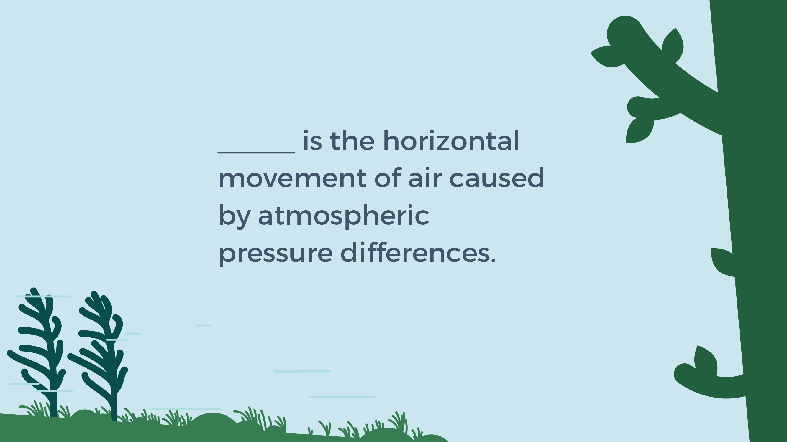

Notes:
We’ve just learned about the vertical movement of air in our atmosphere, caused by differences in temperature. But air also moves horizontally. What do we call the horizontal movement of air? [Answer: wind]. CLICK SLIDE TO REVEAL THE ANSWER.
Just as changes in air temperature cause the density of air to change, these factors also impact air pressure. Warm, less-dense air creates low-pressure zones; cool, denser air creates high-pressure zones. Differences in air pressure generate wind. The greater the pressure difference between zones, the stronger the wind will blow.
When there is little to no wind, pollutants can build up near their source. On the other hand, strong winds can transport pollutants far from their source. It is, therefore, important to know both the speed and direction of wind when predicting air quality. Depending on conditions, areas located downwind of major pollutant sources can be impacted to a greater degree than the area where the pollutants are emitted.

Slide 21
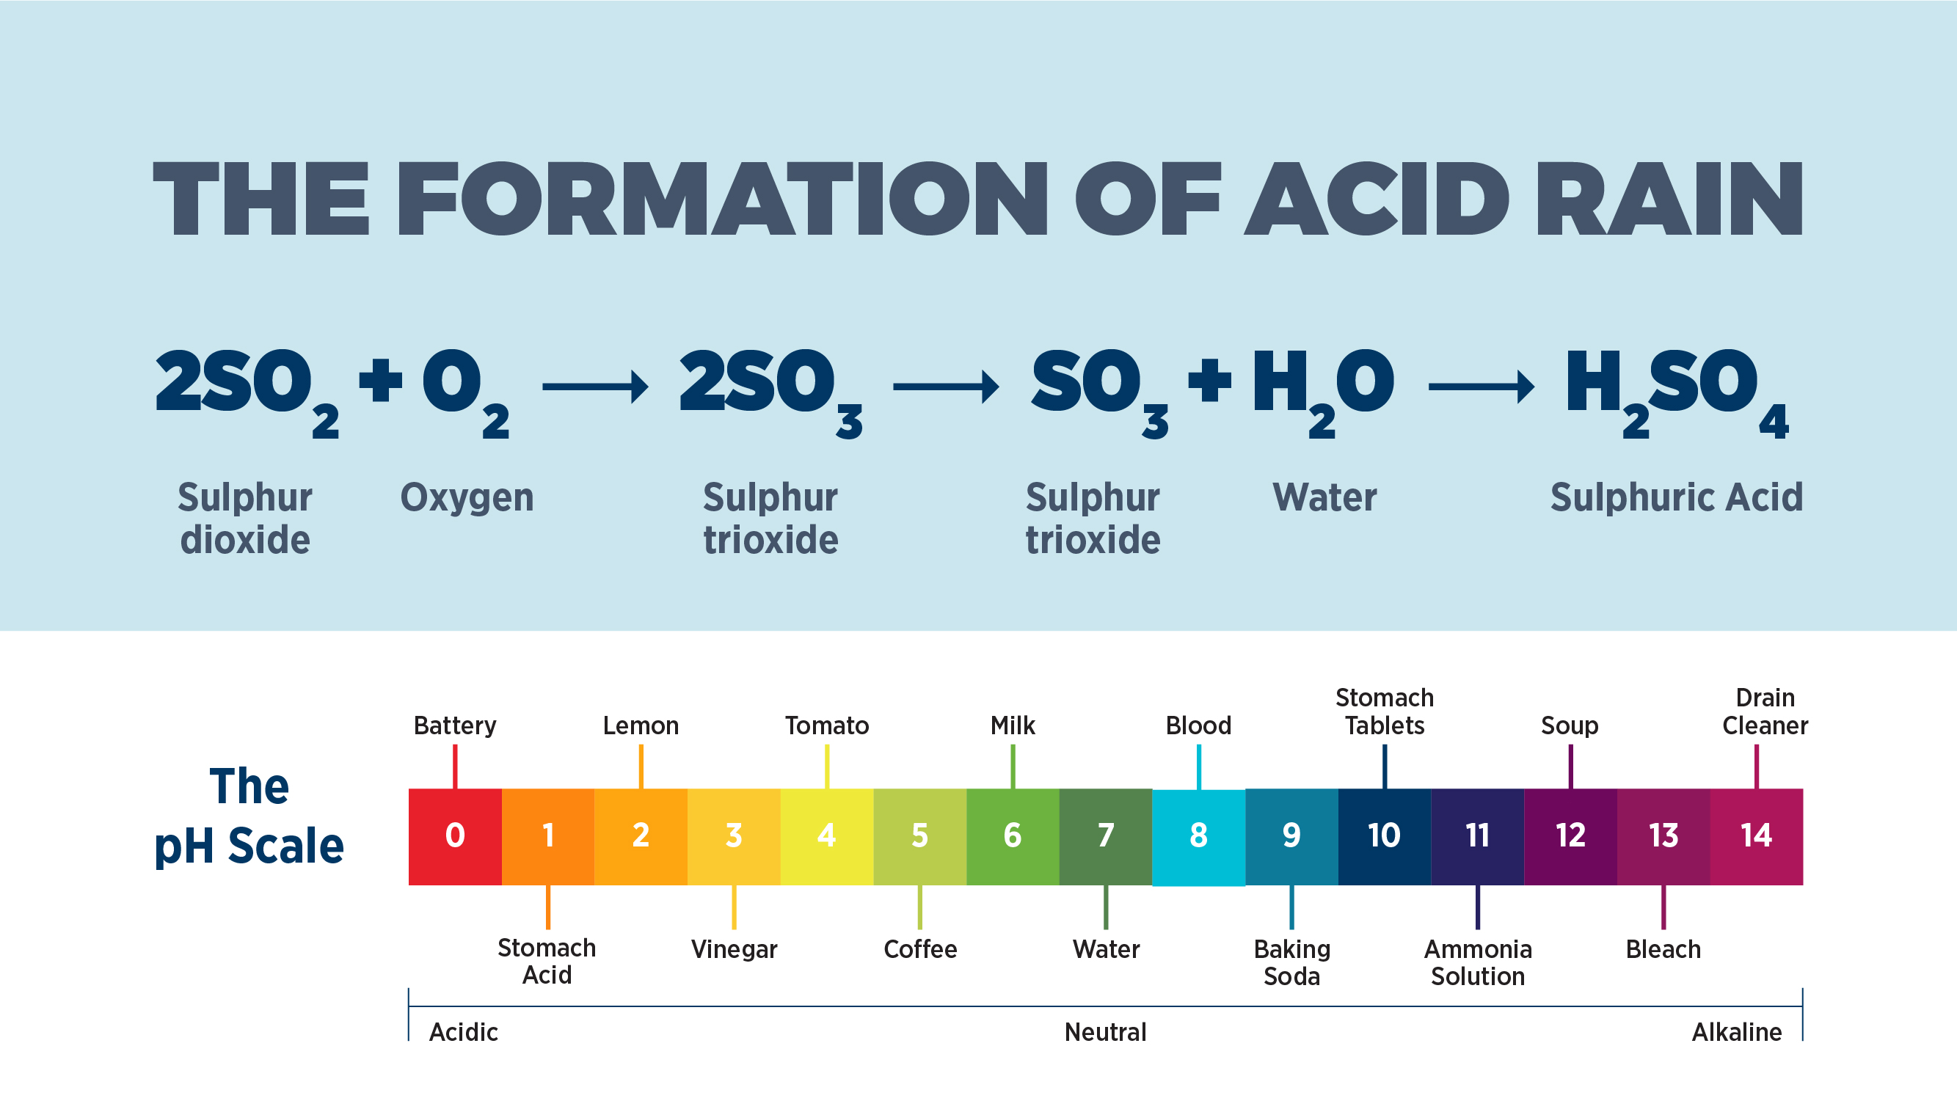
Notes:
Some air pollutants can persist for a long time in the atmosphere and be transported far distances by air currents and wind. This is the case with the chemicals involved in acid rain and why this phenomenon is known as a regional air pollution issue.
Acid rain is any precipitation (rain, snow, and hail) that has an unusually low, or acidic, pH. Clean, unpolluted rain is generally slightly acidic (5.6 pH), while acid rain has a pH between 2 and 4.5. POINT OUT AND EXPLAIN PH SCALE.
Does anyone enjoy lemonade or putting lemon in their water? Lemon juice has a pH of about 2. So, if we can drink acidic beverages, then acid rain can’t be that harmful, right? Wrong. Acid deposition damages forests, aquatic ecosystems, and even buildings.
Acid rain forms when sulphur dioxide and nitrogen oxide emissions (which often come from the burning of fossil fuels) rise into the atmosphere and mix and react with oxygen and water. This process forms acidic secondary pollutants, such as sulphuric acid (H2SO4). POINT OUT CHEMICAL EQUATION ON THE SLIDE, WHICH SHOWS HOW SULPHUR DIOXIDE TRANSFORMS INTO SULPHURIC ACID. A similar reaction happens with nitrogen oxide emissions, leading them to transform into nitric acid (HNO3) and nitrous acid (HNO2).
These pollutants can travel long distances before eventually falling back down to the ground in wet or dry forms. Wet deposition means these pollutants fall back down to Earth’s surface as precipitation, while dry deposition means they come down as gases and dust particles.

Slide 22
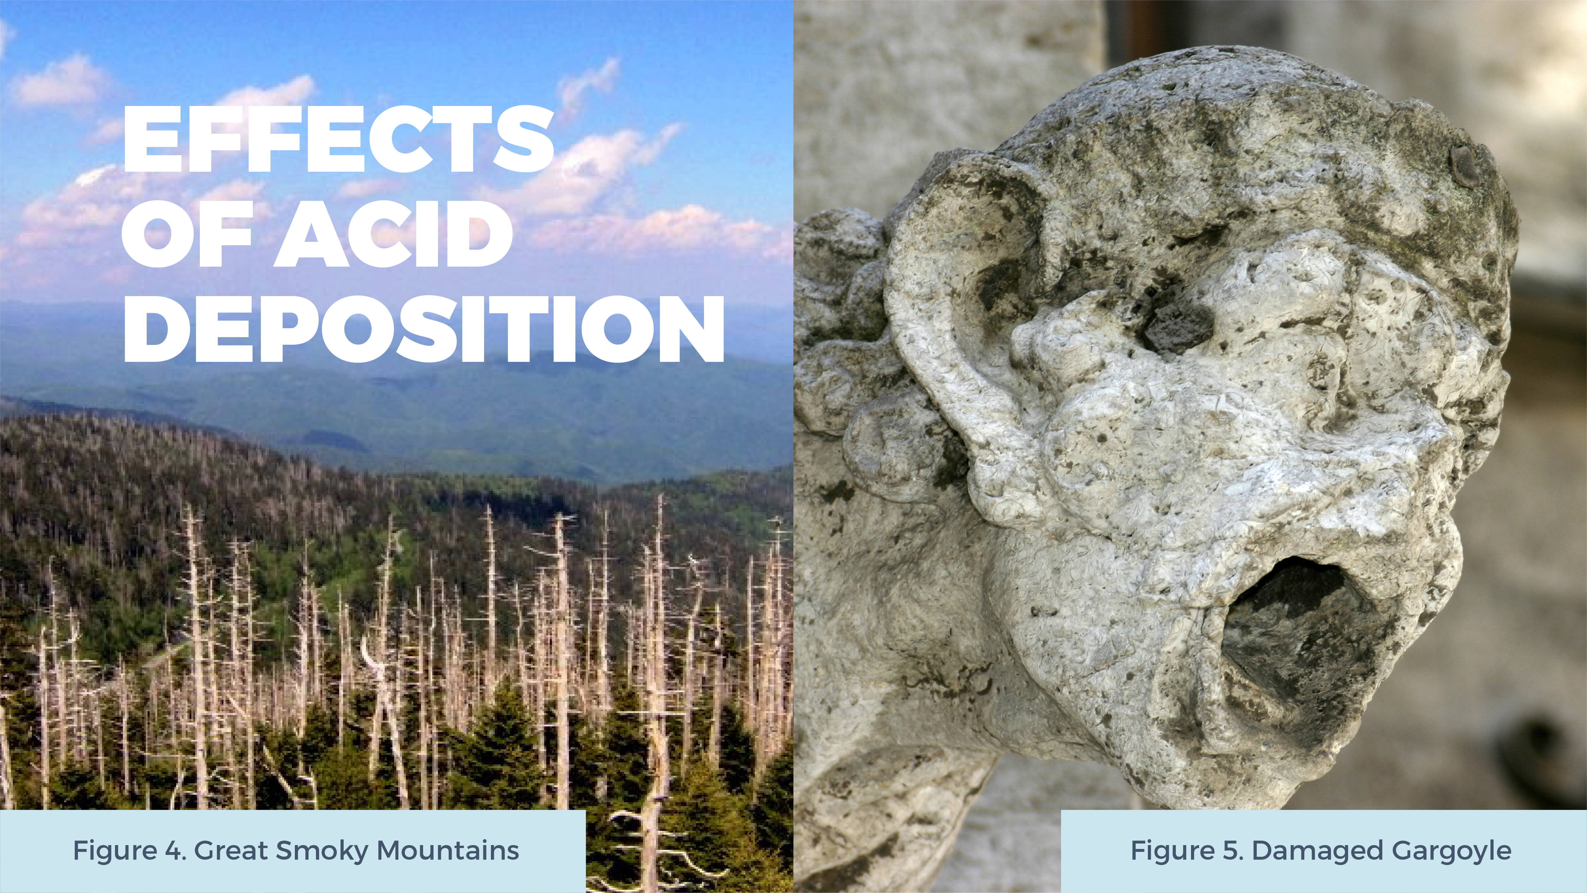
Notes:
The effects of acid deposition are far-reaching. Acid deposition can seep into the ground and remove important nutrients from the soil that trees rely on to grow and thrive. POINT OUT PHOTO ON THE LEFT. Trees found in mountainous regions, or at high elevations, are particularly susceptible to the effects of acid deposition because they come into direct contact with acidic clouds and fog.
Likewise, acid deposition disrupts aquatic ecosystems by changing the pH (acidity) of lakes and streams. This change can be deadly to phytoplankton, fish, frogs, and other creatures that are part of the food web.
Acid rain can also damage buildings, monuments, and cars. The chemicals found in acid rain can cause paint to peel and stone statues to begin to appear old and worn. POINT OUT PHOTO ON THE RIGHT.
Figure 4. Great Smoky Mountains. From Clingmans Dome Newfound Gap by Brian Stansberry, 2006. https://commons.wikimedia.org/wiki/File:Clingmans-dome-newfound-gap-tnnc1.jpg
Figure 5. Damaged Gargoyle. From Gargoyle by Nino Barberi, 2006. https://commons.wikimedia.org/wiki/File:-_Acid_ rain_damaged_gargoyle_-.jpg

Slide 23
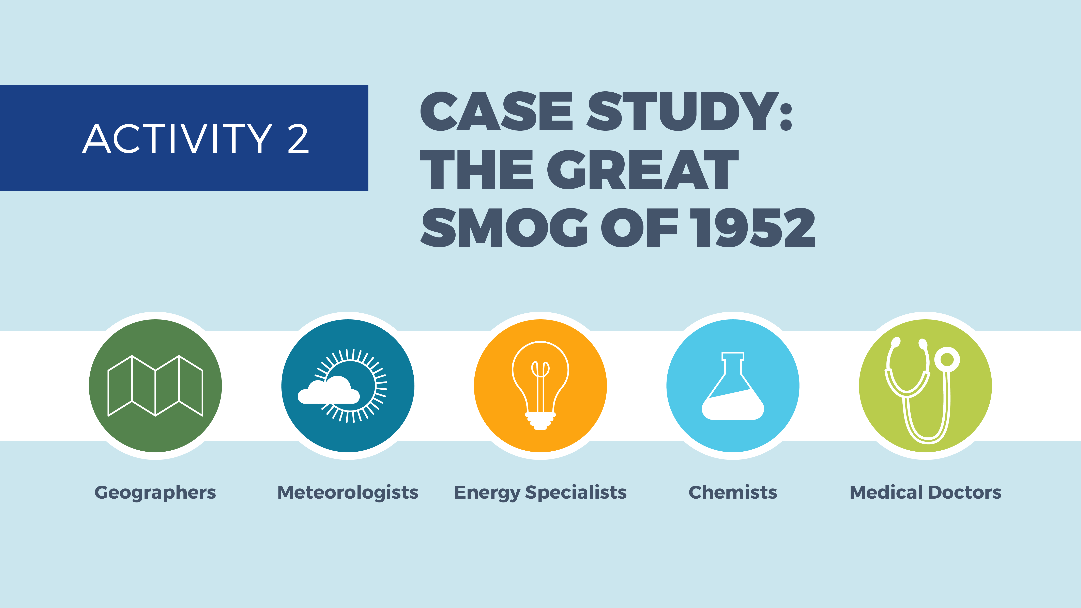
Notes:
Now that you understand some of the factors that affect air quality, you will investigate a historical air pollution tragedy, London’s Great Smog of 1952, and try to determine what made this the deadliest air pollution event in the city’s history.
*See activity instructions in Teacher Guide. To start, read the synopsis of the Great Smog aloud to students followed by the activity premise (both included in the guide).

Slide 24

Notes:
No notes.

Slide 25

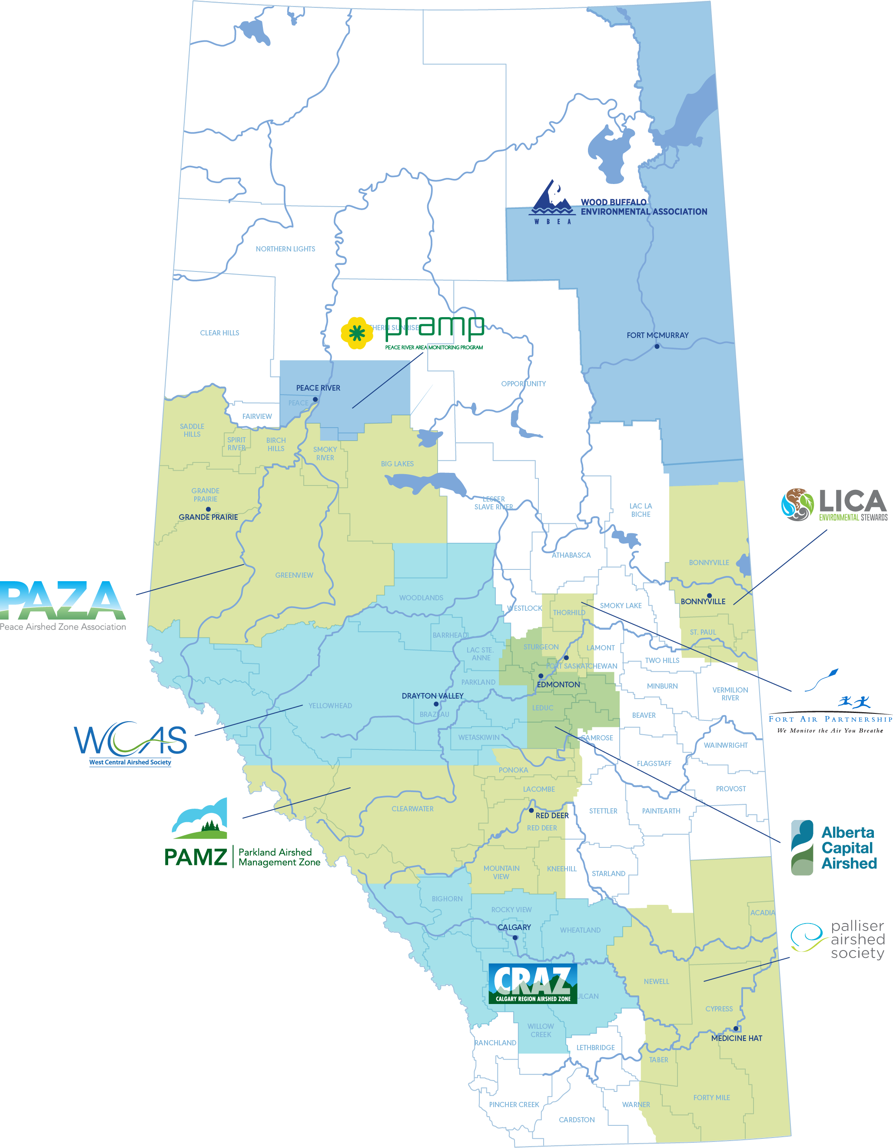

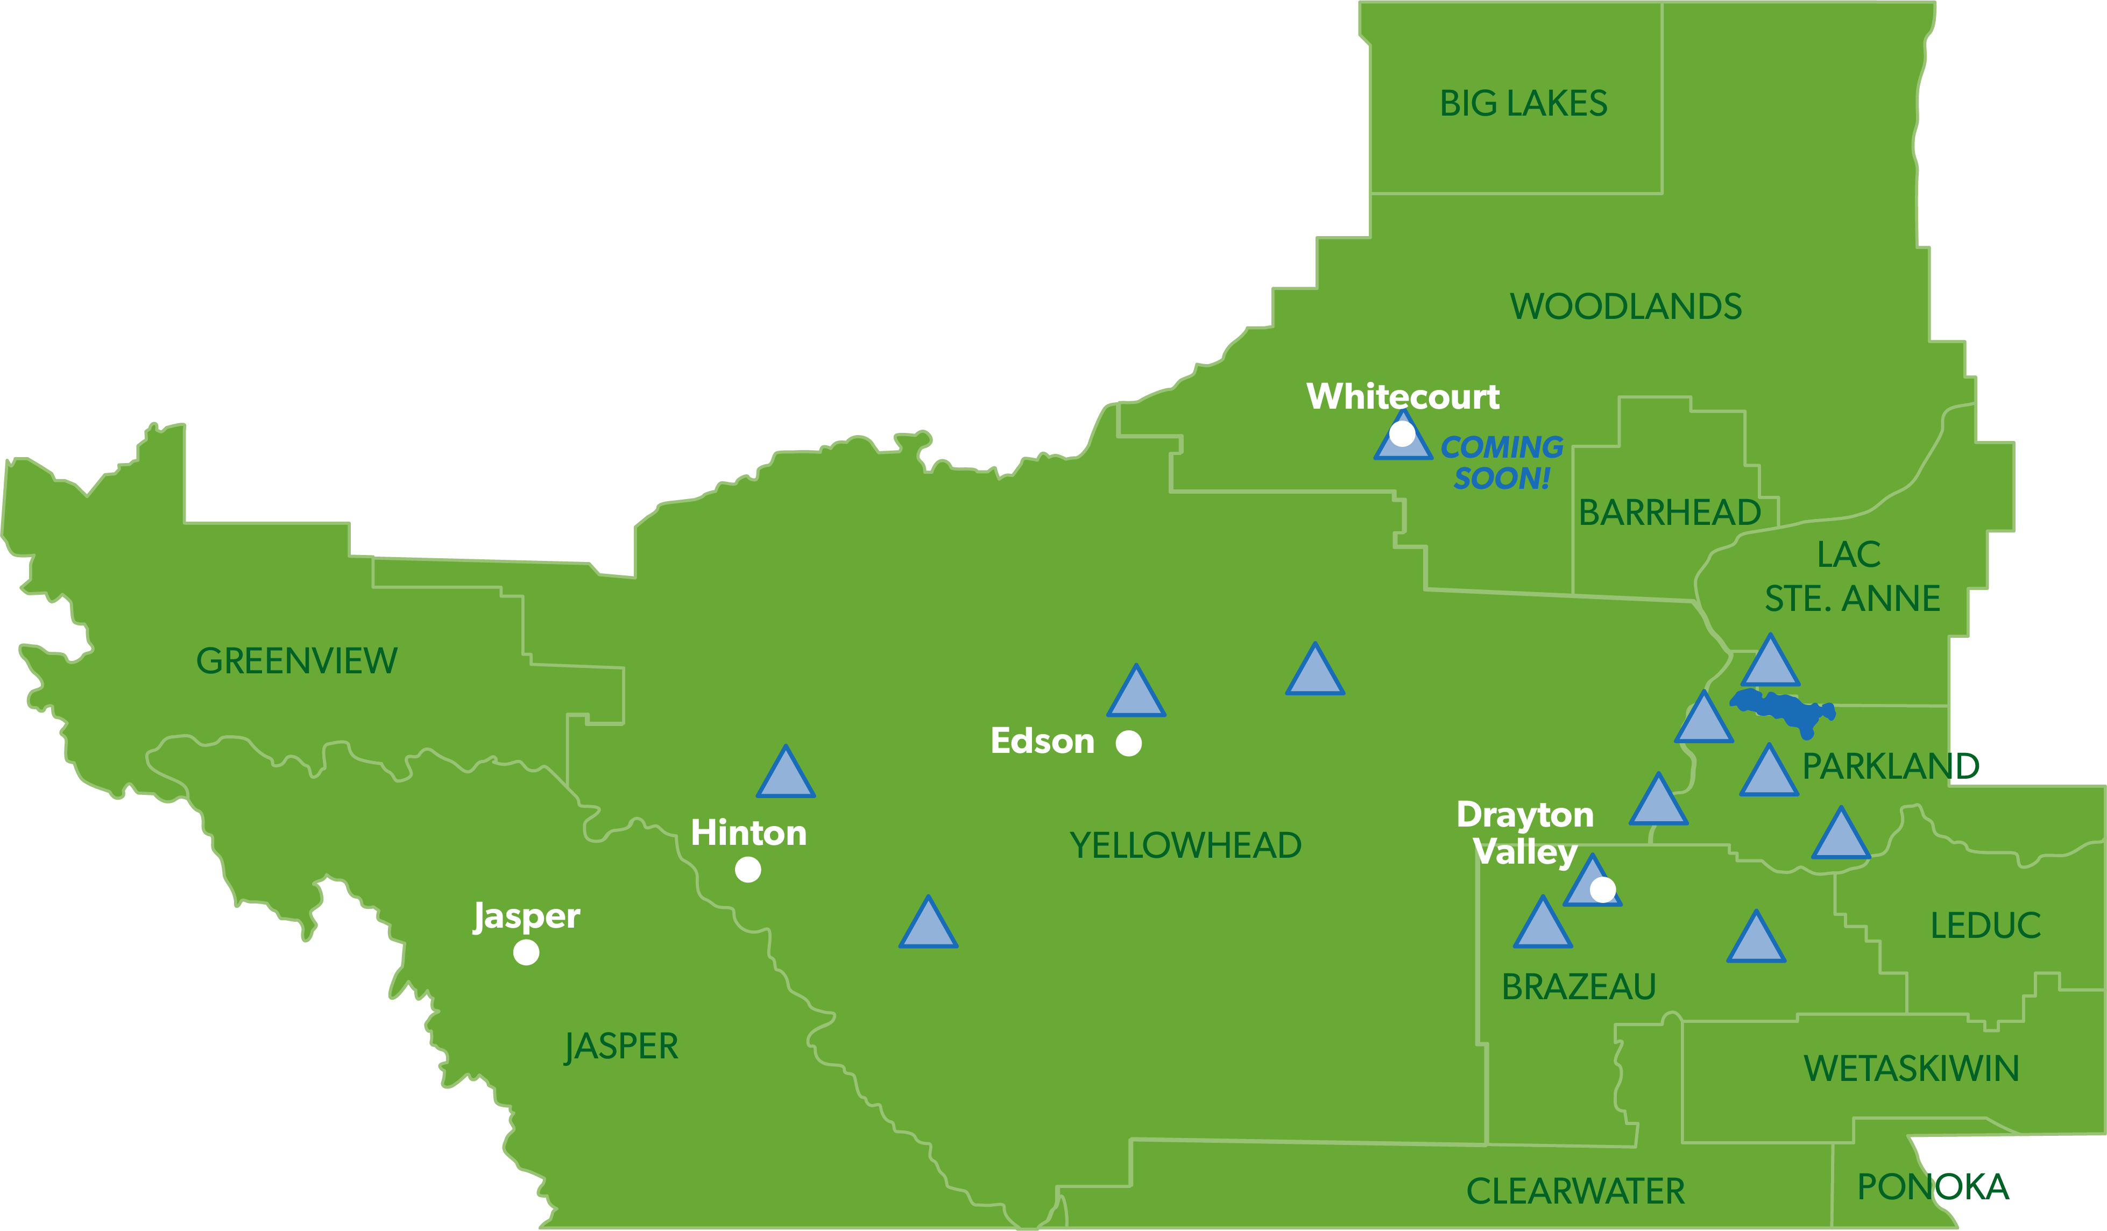
Notes:
Since the Great Smog of 1952, laws, regulations, and systems have been put in place in many countries, including Canada, to help alert the public when air pollution levels are high, and to encourage industries, businesses, and people to reduce their emissions.
Alberta has an air quality management system designed to keep us safe. In our province, there are ten regional Airshed organizations that monitor and report on the quality of the air in their communities.
IDENTIFY THE AIRSHED THAT MONITORS AIR QUALITY IN YOUR REGION (IF OUTSIDE OF AN AIRSHED ZONE, IDENTIFY THE NEAREST ONE). CLICK SLIDE TWICE TO REVEAL ANIMATION. You should now see a blow-up version of the West Central Airshed Society’s air monitoring zone.

Slide 26








Notes:
This video describes how Airsheds function. Pay close attention to the video and complete the sentences on the screen.
WAIT FOR THE VIDEO TO LOAD BEFORE PLAYING. Video will stop automatically when complete. Video Length: 1 minute 3 seconds. *If video is not responding, try this URL: https://www.youtube.com/watch?v=psLtIm9Z_QU
[Answers: air pollutants, weather conditions; governments, Indigenous communities, academics, the public, and industries].
CLICK SLIDE TO REVEAL THE ANSWERS. THEN DISCUSS THE FOLLOW-UP QUESTION: Why is it important that these groups have access to reliable air quality data? [Answers will vary but be sure to discuss each group individually].

Slide 27
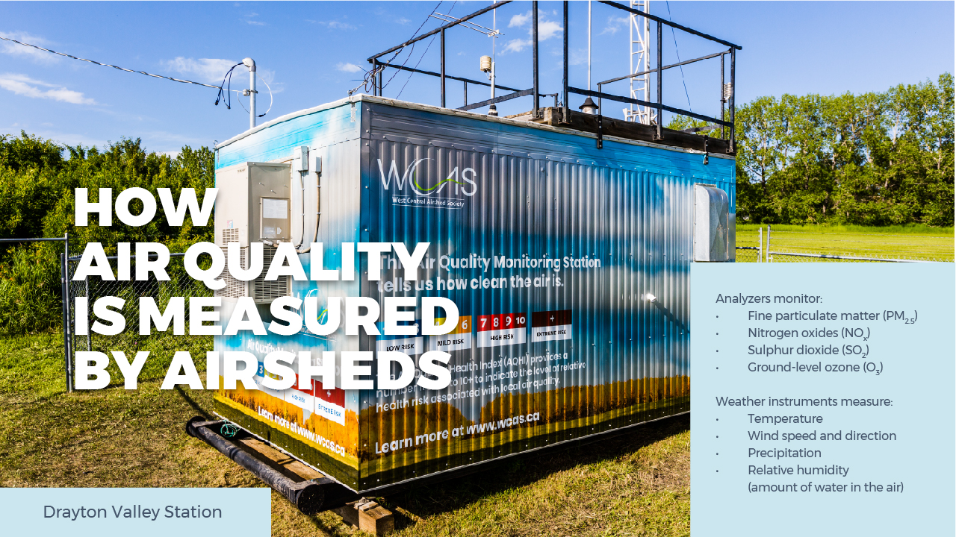
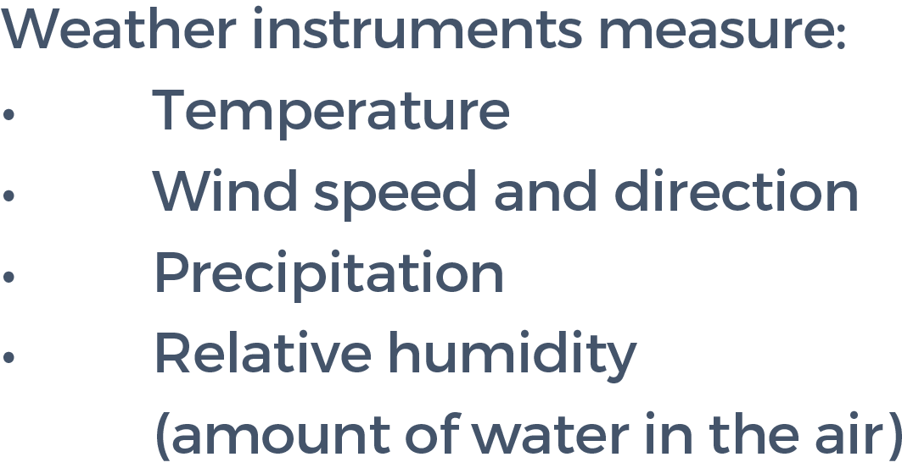
Notes:
Continuous air monitoring stations, like this one in Drayton Valley (WCAS), house special analyzers that provide on-the-spot measurements of pollutant concentrations, so that Airsheds can keep us informed about the quality of the air in our communities. These analyzers monitor the pollutants that are most harmful to human health:
Fine particulate matter (PM2.5 ) — tiny, microscopic particles that can enter deep into our lungs
Nitrogen oxides (NOx)
Sulphur dioxide (SO2 )
Ground-level Ozone (O3 ) — *This should not be confused with the ozone layer in the stratosphere, which forms naturally.
These stations also contain weather instruments, which measure:
CLICK SLIDE TO REVEAL ANIMATION.
Temperature
Wind speed and direction
Relative humidity (the amount of water in the air versus the amount of water the air can hold)
Precipitation (rain, snow, etc.)

Slide 28
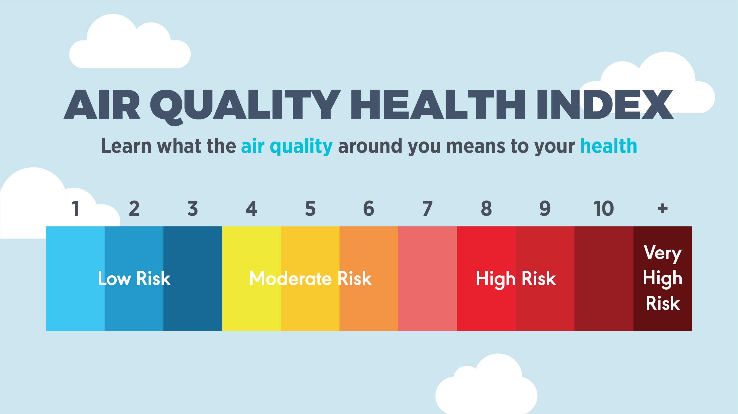
Notes:
Data from Airshed monitoring stations contribute to the Air Quality Health Index (AQHI), a tool that helps us understand how air quality can impact our health.
The AQHI is a colour-coded numerical index used to communicate levels of local air pollution to Canadians.
The AQHI reading represents the relative risk of a group of common air pollutants that are known to harm human health. Three pollutants were chosen as indicators of the overall outdoor air quality:
Fine particulate matter
Nitrogen dioxide
Ground-level ozone

Slide 29
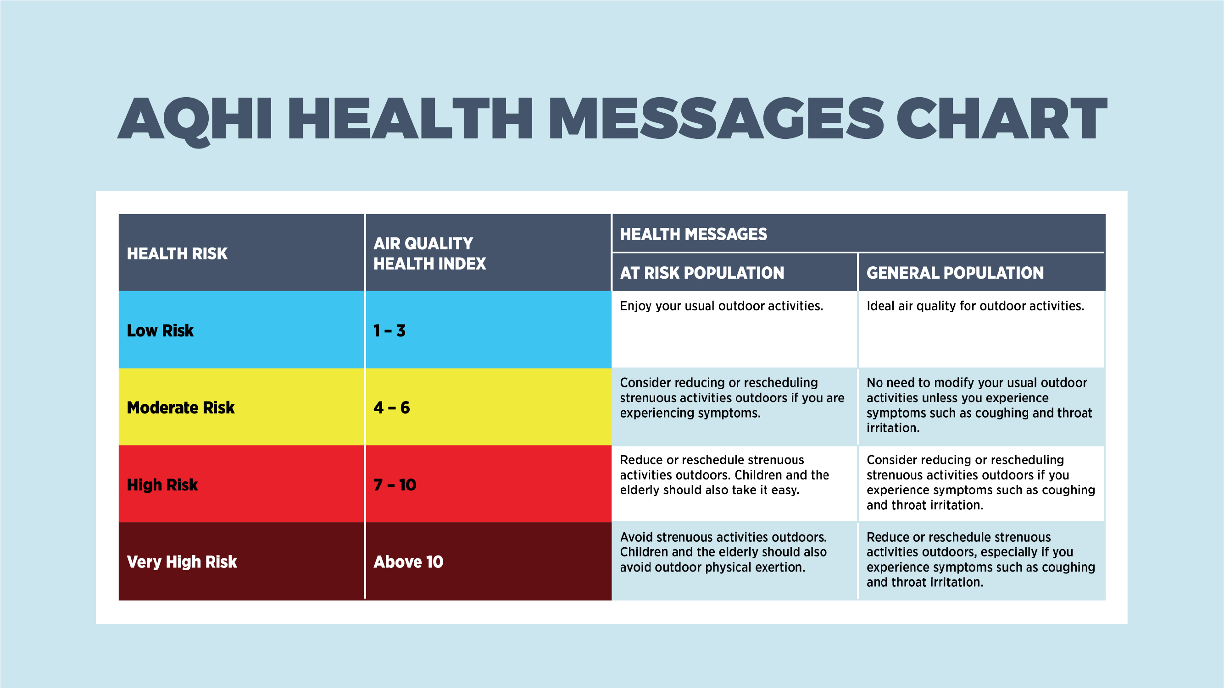
Notes:
The AQHI provides “health messages” for specific segments of the population. These messages are intended to help people make decisions about their outdoor activities. Messages vary depending on whether an individual fits into the “general population” or is considered part of an “at risk” group.
ASK STUDENTS TO OBSERVE THE HEALTH MESSAGES AND MAKE GENERAL OBSERVATIONS. BE SURE TO TOUCH ON THE FOLLOWING POINTS DURING YOUR DISCUSSION:
The general population typically does not need to change their outdoor plans on account of poor air quality except when the AQHI is ≥ 7, or “high risk.”
Some people should consider taking precautions to reduce their exposure to air pollution, even during “moderate risk” situations.
When the AQHI is ≥ 7, at risk populations are urged to change their plans if those plans involved outdoor activities.

Slide 30


Notes:
Who do you think is most likely to suffer from poor air quality? In other words, who would fit into Health Canada’s “at risk” group on the AQH chart?
CLICK SLIDE TO REVEAL ANSWERS. [Answers: people with lung diseases (such as asthma) or heart conditions, the elderly, young children, pregnant women, people working or participating in strenuous activities outdoors, such as sports].

Slide 31
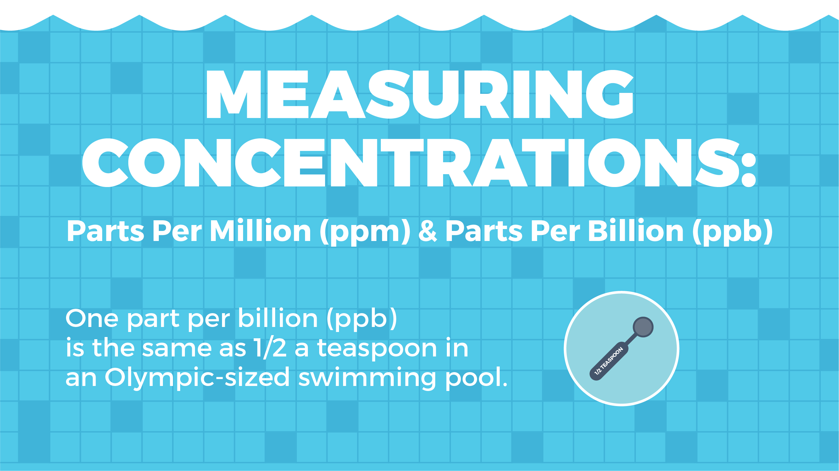
Notes:
In order to calculate the AQHI, scientists must measure the concentration of certain pollutants in our air. These levels are measured in parts per million (ppm) and parts per billion (ppb).
In science, parts per million and parts per billion are used to measure concentrations when a small amount of one substance makes a big impact. Parts per million (ppm) counts the number of units of one substance per one million units of another substance. Likewise, parts per billion (ppb) counts the number of units of one substance per one billion units of another substance.
It can be hard to visualize these types of ratios. To help, think of it this way… one part per million is roughly equivalent to:
A single granule of sugar among 273 sugar cubes
One minute in two years
One drop of water in twenty-five 2L bottles
Part per billion measures even smaller concentrations. Some analogies would be:
One pinch of salt in 10 tons of potato chips
One second in approximately 32 years
Half a teaspoon of water in an Olympic-sized swimming pool
Alberta sets limits for air pollutant concentrations. If pollutants go above these levels, it means the AQHI reading will be high. For example:
159 ppb for nitrogen dioxide
76 ppb for ground-level ozone

Slide 32

Notes:
See activity instructions in Teacher Guide.

Slide 33
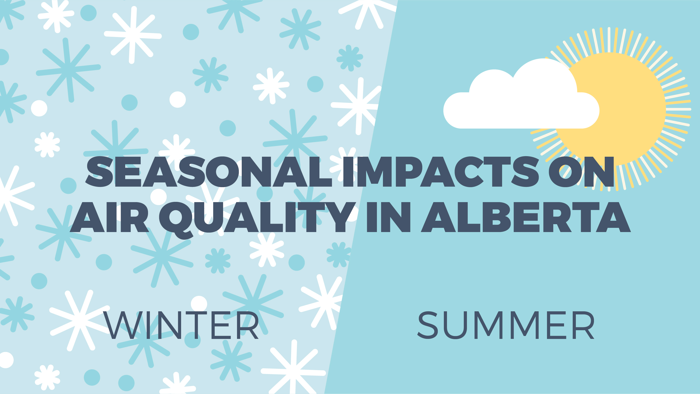
Notes:
Albertans enjoy relatively good air quality; however, air pollution can sometimes reach high levels on account of weather conditions, natural disasters and, occasionally, industrial accidents.
In Alberta, winter and summer are characterized by vastly different weather conditions, and for this reason, there are unique air quality issues associated with each season.

Slide 34
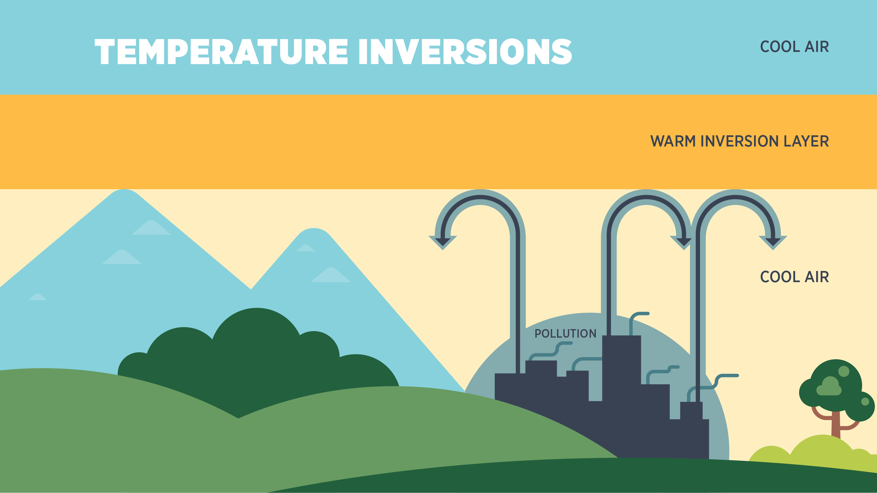
Notes:
A temperature inversion is a weather event that limits the vertical movement of air (convection) and can contribute to poor air quality.
If you recall from the previous module, we normally have warm air at ground level, and cooler air above, which allows air to rise easily and disperse pollutants. In a temperature inversion, the temperatures are upside down: the cooler air is at ground level and the warmer air is higher up. POINT OUT IMAGE ON SLIDE. The warm inversion layer above acts like a lid, preventing the cooler air from rising and trapping pollutants near the ground, where we live and breathe.
During a temperature inversion, smoke from chimneys, fumes from vehicles, and pollutants coming from other sources can build up and reach unhealthy concentrations. Depending on conditions, inversions can last for hours or even days.

Slide 35
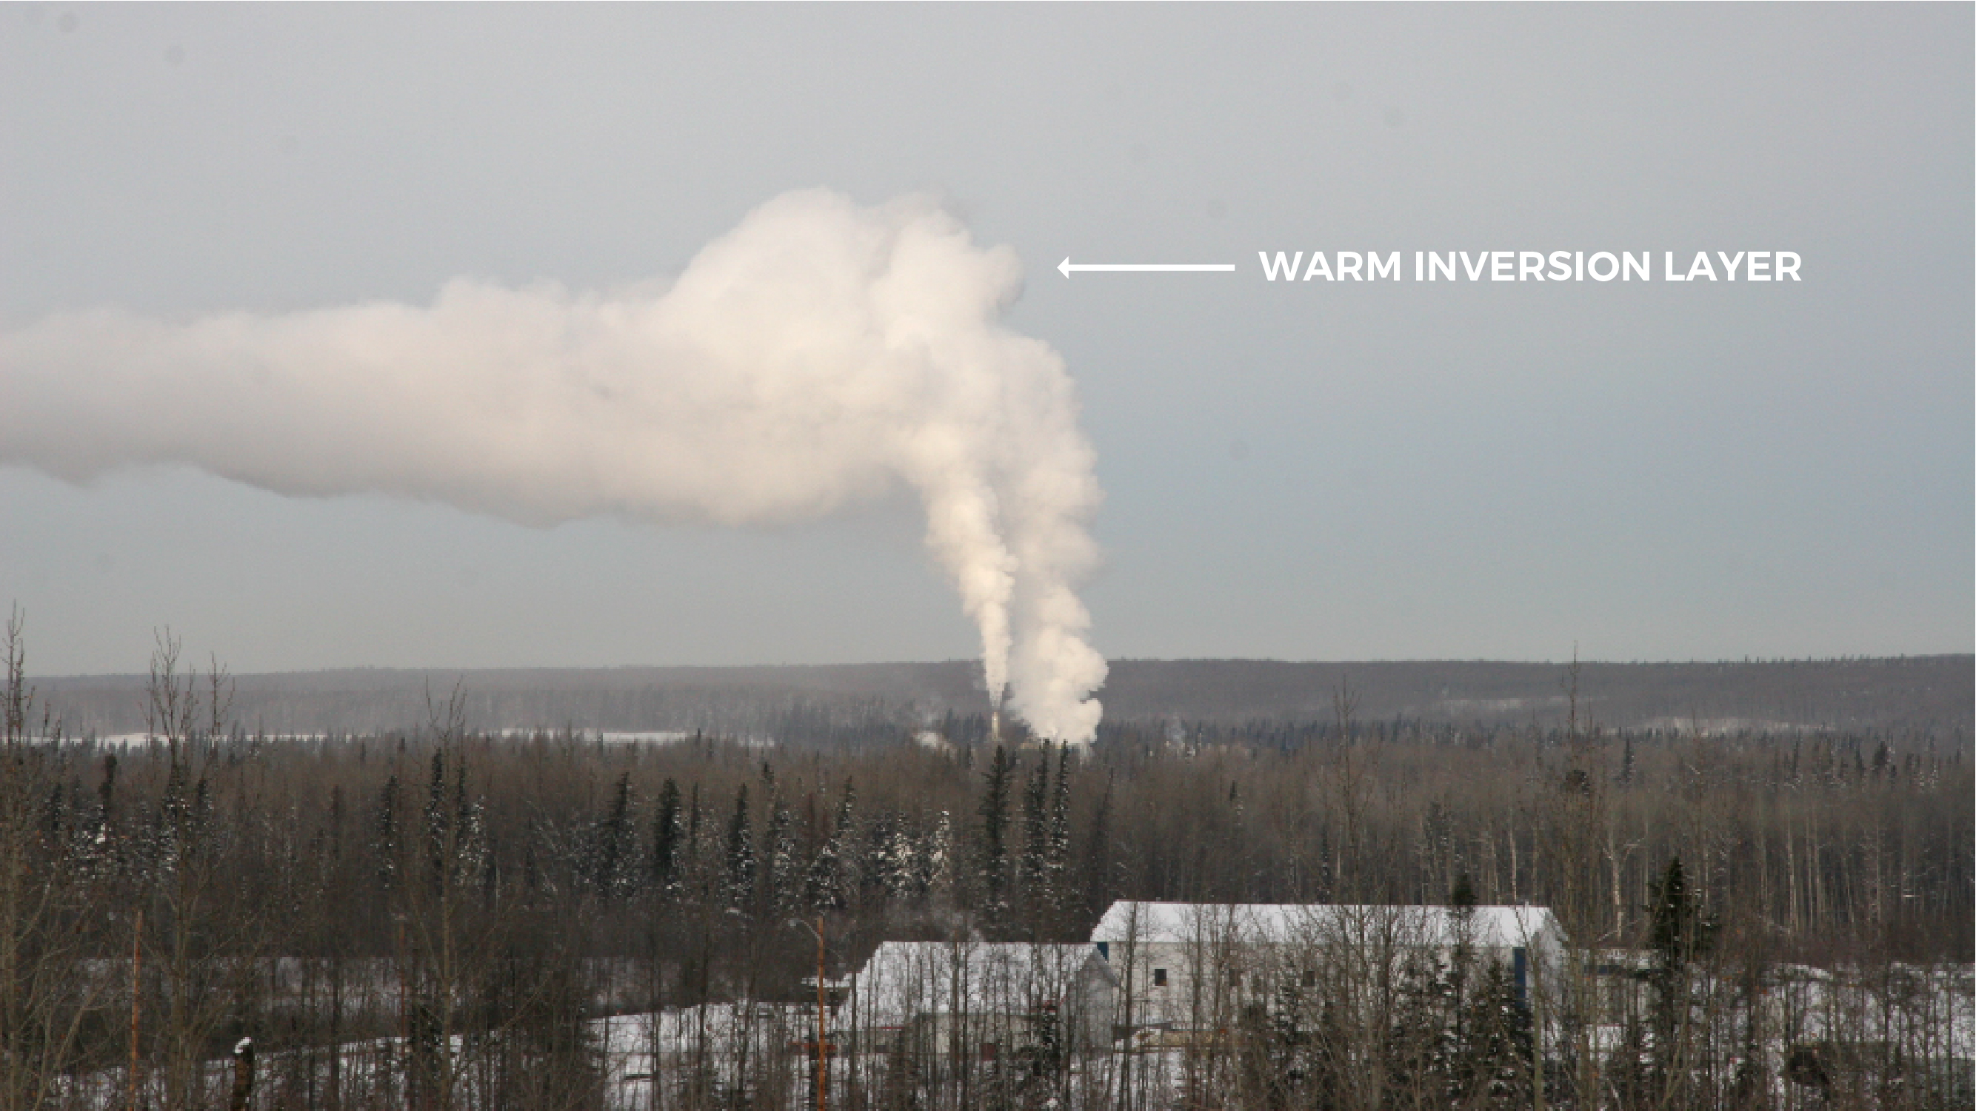
Notes:
This photograph shows a temperature inversion in action. We can see that the exhaust coming from a nearby building rises up into the sky, but when it reaches the warmer inversion layer, its vertical movement is restricted.

Slide 36
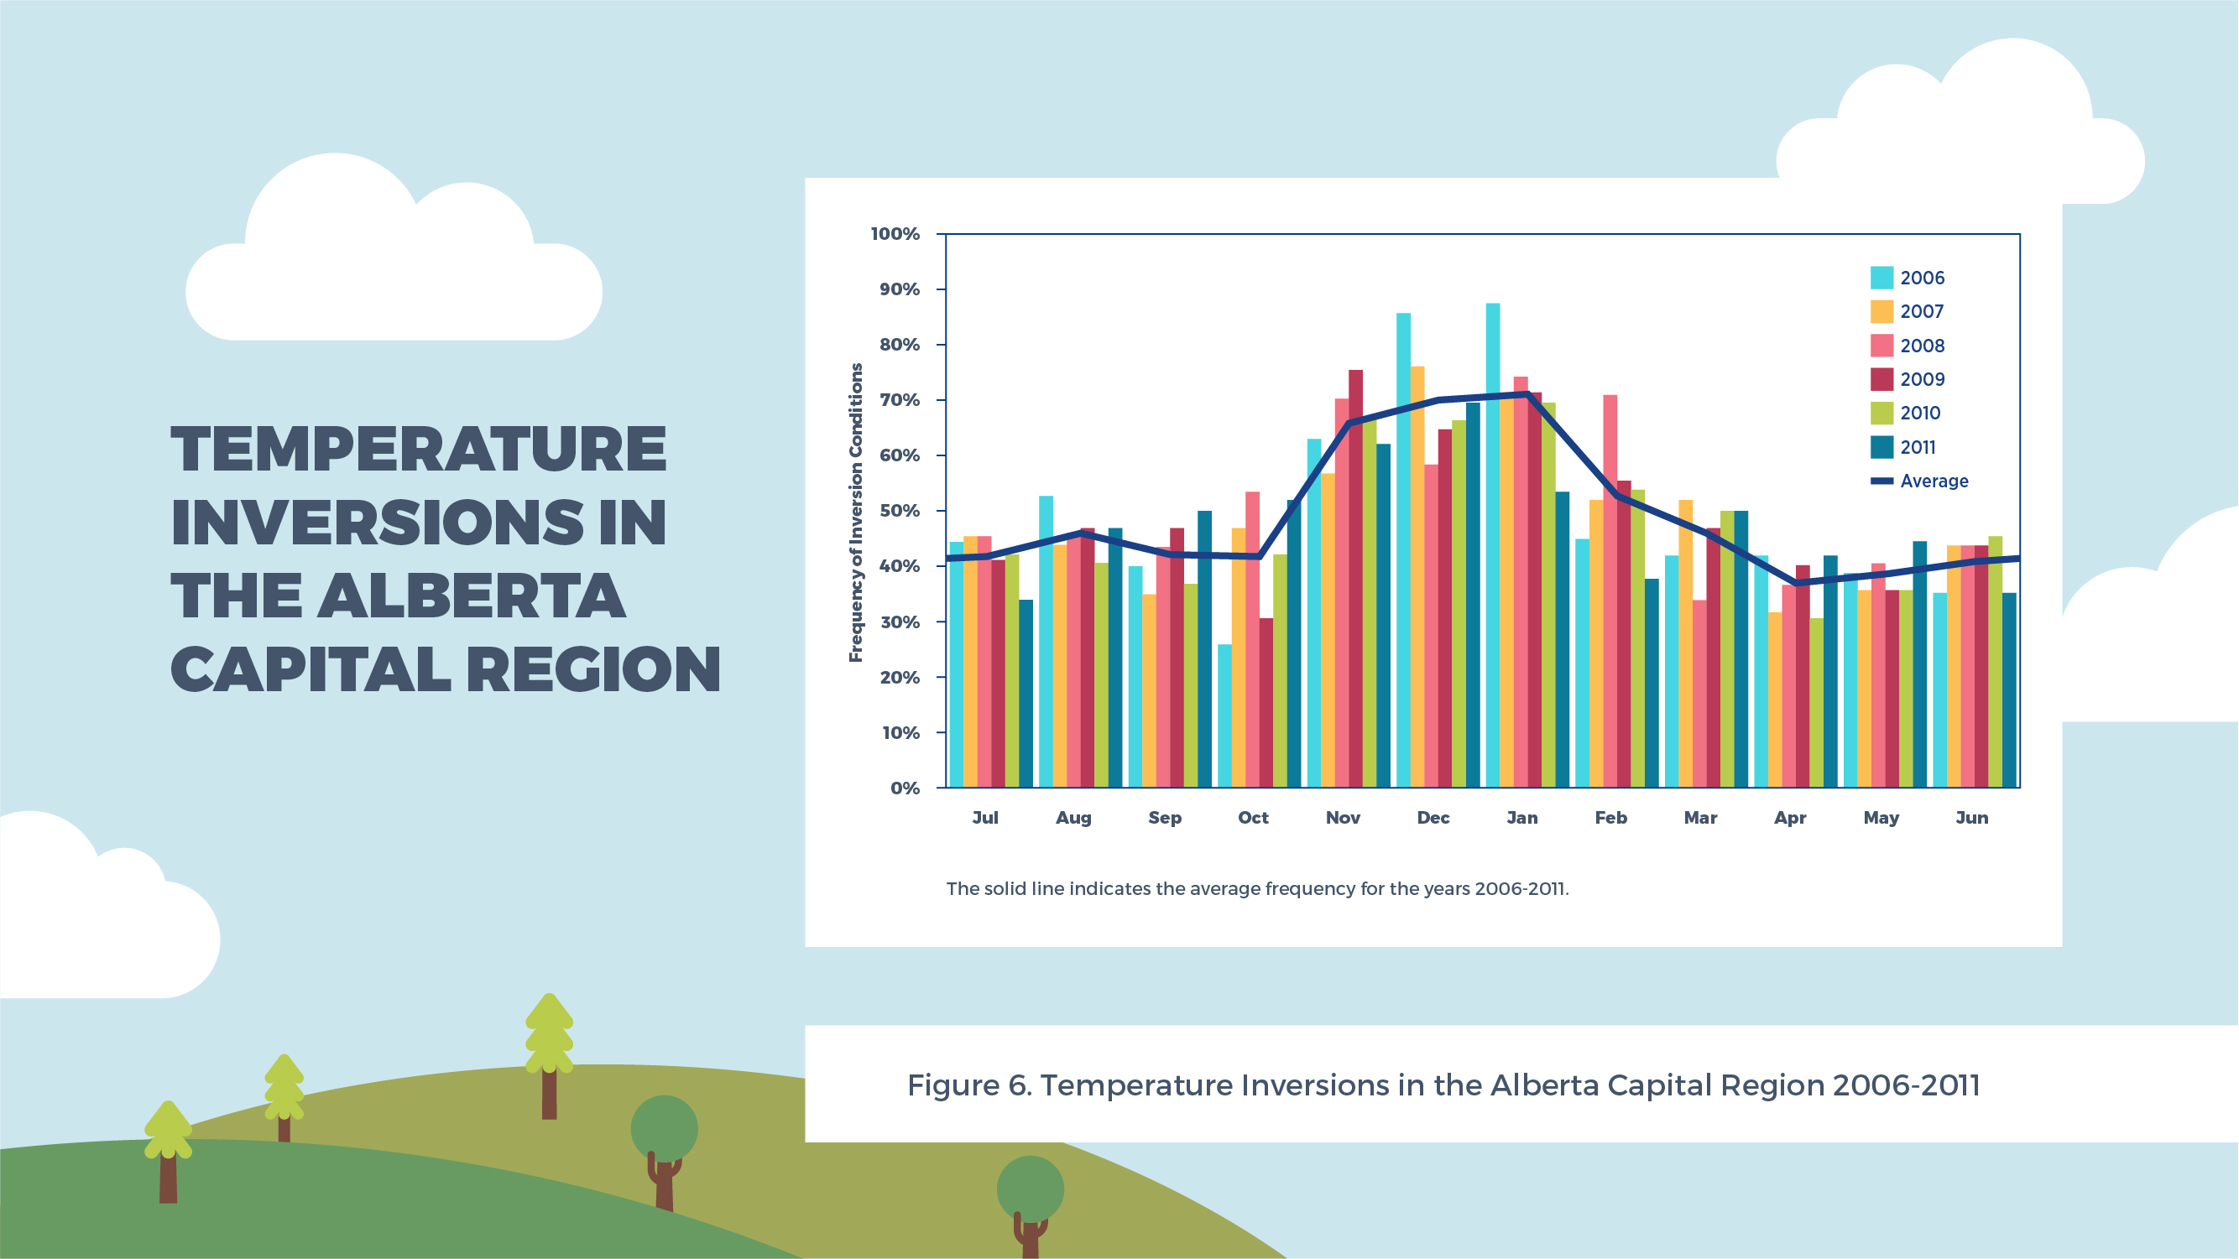
Notes:
Temperature inversions can occur at anytime of year, but in Alberta they are most common in one particular season…. Look carefully at this graph, which shows how often temperature inversions occur in the Alberta Capital Region. In what season does the Edmonton area experience the most temperature inversions? [Answer: winter].
In winter, the air at ground level is often cooler than the air further up in the troposphere for several reasons. At this time, the sun is weaker, so Earth’s surface does not absorb as much heat during the day and nights are at their longest, giving the ground a lot of time to cool off. Likewise, bright white snow reflects incoming sunlight that would otherwise warm the ground and cause pollutants to rise up into the atmosphere and spread out. Under these conditions, pollutants have no where to go, and we get what is known as “winter smog.”
It is not only big cities like Edmonton that are prone to winter smog. Smaller communities and especially those situated in valleys, like Whitecourt, Drayton Valley, and Hinton, often experience temperature inversions and the poor air quality that comes with it.
What activities might we do more often in winter than in other seasons that could cause emission levels to rise? [Answers: driving, heating our homes, making wood fires, etc.]. Increased vehicle usage, home heating, and wood burning in the winter months generates large amounts of air pollution that can get trapped under inversion layers.
Figure 6. Temperature Inversions in Alberta Capital Region 2006-2011. From Figure 9. Frequency of Inversions in the Capital Region Detected by Month and Year for 2006-2011. In Capital Region Fine Particulate Matter Science Report, pg. 15, by Government of Alberta, 2014. https://open.alberta.ca/dataset/51e77770-bf72-4851-8a6b-240d0f5b3856/ resource/88698cff-7d86-4dc7-964a-4dc6d0433c04/download/2014-CapitalRegion-PM-ScienceReport-Dec2014.pdf

Slide 37


Notes:
Idling, or leaving a car’s engine running while the vehicle is in park, is a major source of air pollution. Unsurprisingly, warming up our cars in the cold winter months is one of the most common reasons Canadians give for idling. In fact, research suggests that in the peak of winter, many Canadian motorists idle their vehicles for about eight minutes a day, resulting in a combined total of more than 75 million minutes of idling in one day. This day alone uses over 2.2 million litres of fuel and produces over five million kilograms of greenhouse gases (GHGs) – dangerous pollutants that are altering Earth’s climate.
WAIT FOR THE VIDEO TO LOAD BEFORE PLAYING. Video will stop automatically when complete. Video length: 1 minute 9 seconds. *If video is not responding, try this URL: https://www.youtube.com/ watch?v=BPtYFiu4sEU
Alberta’s Airshed organizations recommend limiting warm-up times and remote car starter usage to 60 seconds or less. This action has many positive impacts: It saves us fuel and money; helps to reduce air pollution and improve local air quality; and, as we’ve seen from the video, it is better for the engine itself.

Slide 38
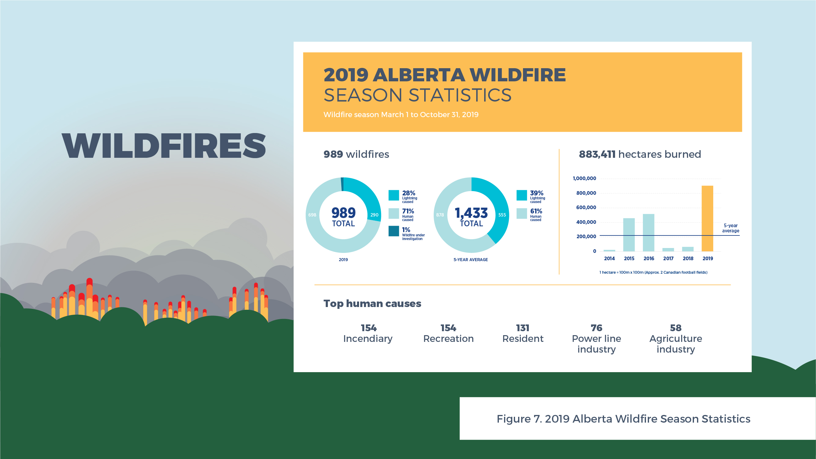
Notes:
Alberta’s hot and sunny days of summer are associated with their own air quality problems, the most infamous of which is wildfire smoke.
In recent years, Alberta’s worst air quality episodes have been associated with wildfires. 2019 was a particularly bad year for wildfires in Alberta (REFERENCE THE INFOGRAPHIC ON SLIDE). That year, more than 883,000 hectares of land area burned in the province, which is over 3.5 times more land than the five-year average. Lightning ignited 1/3 of the wildfires in Alberta in 2019, while the other 2/3 of fires were started by human activity.
In addition to hot temperatures and dry conditions, what other weather condition plays a large role in wildfires? [Answer: wind]. Strong winds enable fires to grow quickly, hopping from tree to tree.
Figure 7. 2019 Alberta Wildfire Season Statistics. From 2019 Alberta Wildfire Season Statistics, by Government of Alberta, 2020. Retrieved October 5th, 2020 from https://wildfire.alberta.ca/resources/maps-data/default.aspx

Slide 39
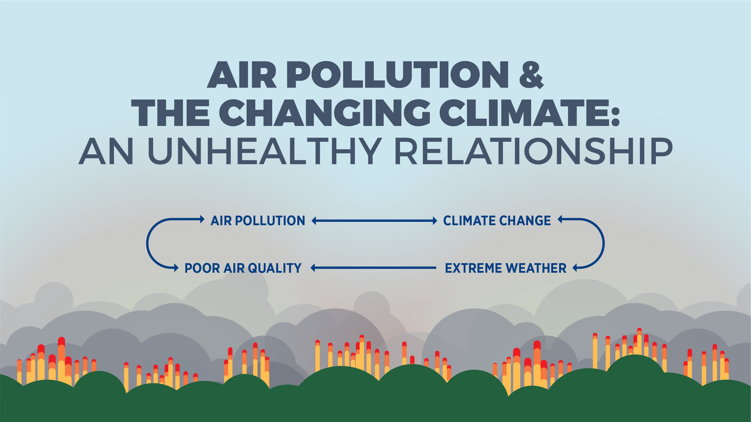
Notes:
Air pollution and climate change are closely related, each affecting the other. Some pollutants cause the Earth to warm, while others cause a temporary cooling effect.
Greenhouse gas emissions (such as carbon dioxide, methane, and nitrous oxide) contribute to climate change by absorbing infrared radiation that escapes from Earth’s surface. This phenomenon traps heat in our atmosphere and creates an unwanted greenhouse effect.
Because of the Earth’s changing climate, we are experiencing more extreme weather that, in turn, can impact local air quality. Wildfires are a good example of this relationship. With the changing climate, Alberta is experiencing more heat waves and drought. These hot and dry conditions lead to more frequent and intense wildfires during the summer. Wildfire smoke creates poor air quality because it contains a mixture of harmful gases and small particles. Of all the pollutants generated by wildfires, fine particulate matter poses the greatest risk to human health.

Slide 40
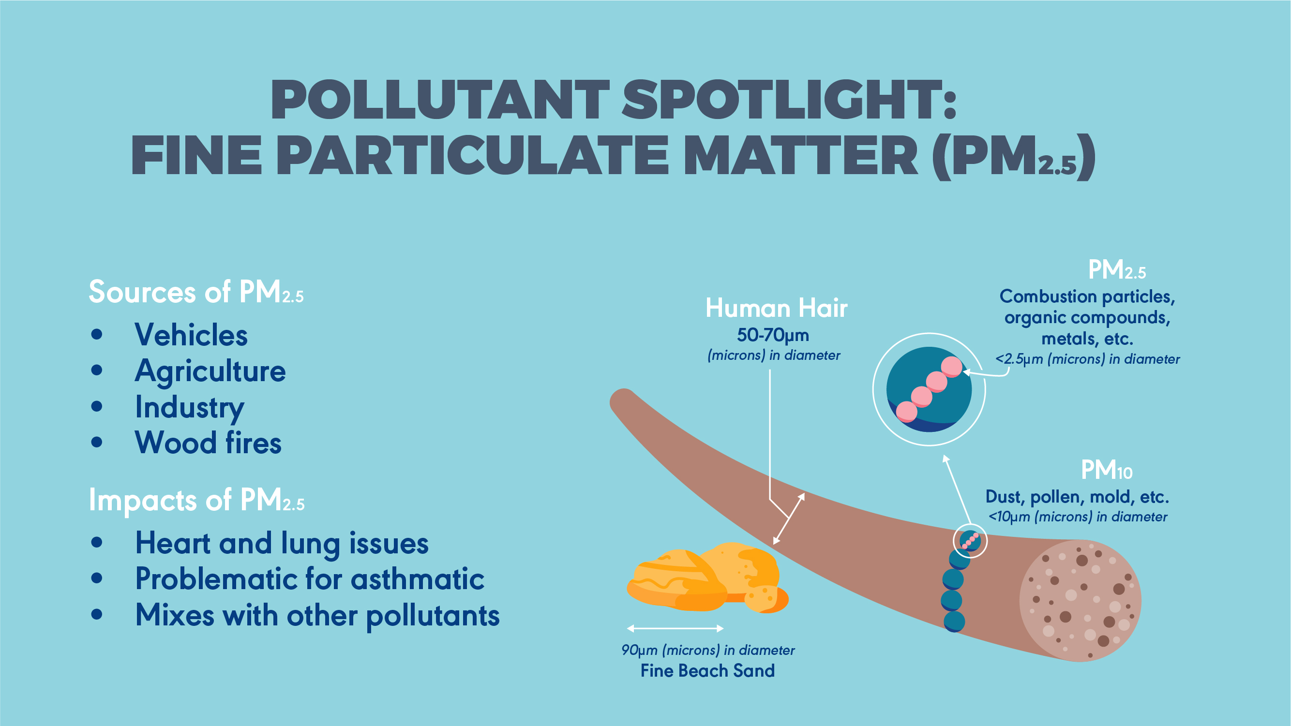
Notes:
Your body can get rid of unwanted substances by coughing, sneezing, or swallowing. However, some particles are so small they can make their way deep into your lungs. This is the case with fine particulate matter. Fine particulate matter consists of tiny particles that are 30 times smaller than human hair and invisible to the naked eye. POINT OUT IMAGE COMPARING THE SIZE OF HUMAN HAIR TO PARTICULATE MATTER. Sources of fine particulate matter include vehicles, agriculture, wood burning, and industry.
There are two main types of particulate matter, PM₁₀ , which includes particles less than 10 microns in diameter, and PM_{2.5} (what we call “fine particulate matter”), which includes particles less than 2.5 microns in diameter. The latter is of more concern to air quality scientists. Exposure to high levels of fine particulate matter is problematic for people with asthma and can cause heart and lung issues, especially in older populations.

Slide 41
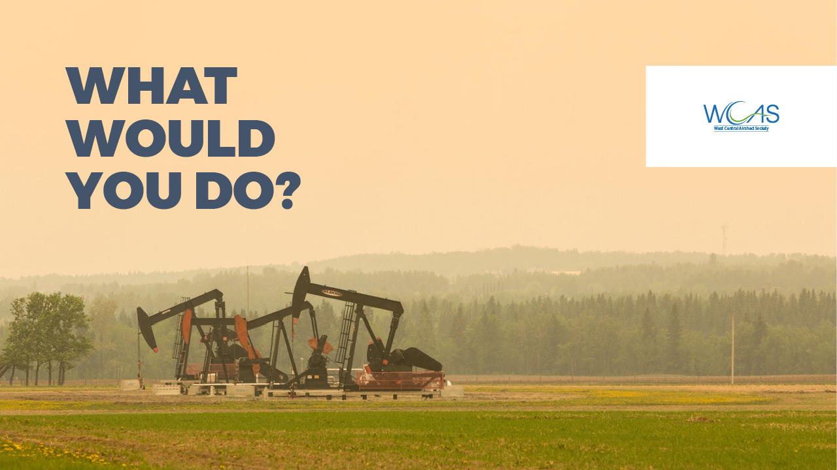
Notes:
This is a photo taken in the Drayton Valley/Brazeau County area on May 30th, 2019. On this date, the area's AQHI jumped to 10+ (i.e., “very high risk”) because of wildfire smoke blown in from northern Alberta. If today’s AQHI was at a similar level, how would you modify your daily routine to protect your health? What types of outdoor activities would you consider reducing or rescheduling?

Slide 42

Notes:
See activity instructions in Teacher Guide.

Slide 43

Notes:
No notes.

